Slide 1
UNIT – II: 8086 PROGRAMMING
Program Development Steps:
Major steps in developing an assembly language program
Defining the Problem
Representing program operations
Finding the right instructions
Writing a program
Defining the problems
Find out the problem.
For example: Sensing temperature, detecting fire, detecting smock, decoder-encoder, Intelligent machine controller etc.
Representing program operations
Formula or sequence of operations used to solve a programming problem is called as the algorithm.
There are two ways of representing algorithms:
  Flowchart
  Structured programming and pseudo code
Finding the right instructions
Instructions in 8086 are mainly divided into following categories
Data Transfer Instructions
Arithmetic Instruction
Bit manipulation Instruction
String Instruction
Program execution transfer Instruction
Processor control Instruction
Writing a program
We need to do the following steps to write the program effectively:
  INITIALIZATION INSTRUCTIONS: used to initialize various parts of the program like segment registers, flags and programmable port devices.
  STANDARD PROGRAM FORMAT: it’s a tabular format containing ADDRESS, DATA OR CODE, LABELS, MNEM, OPERAND(S) and COMMENTS as the columns.
1

Slide 2
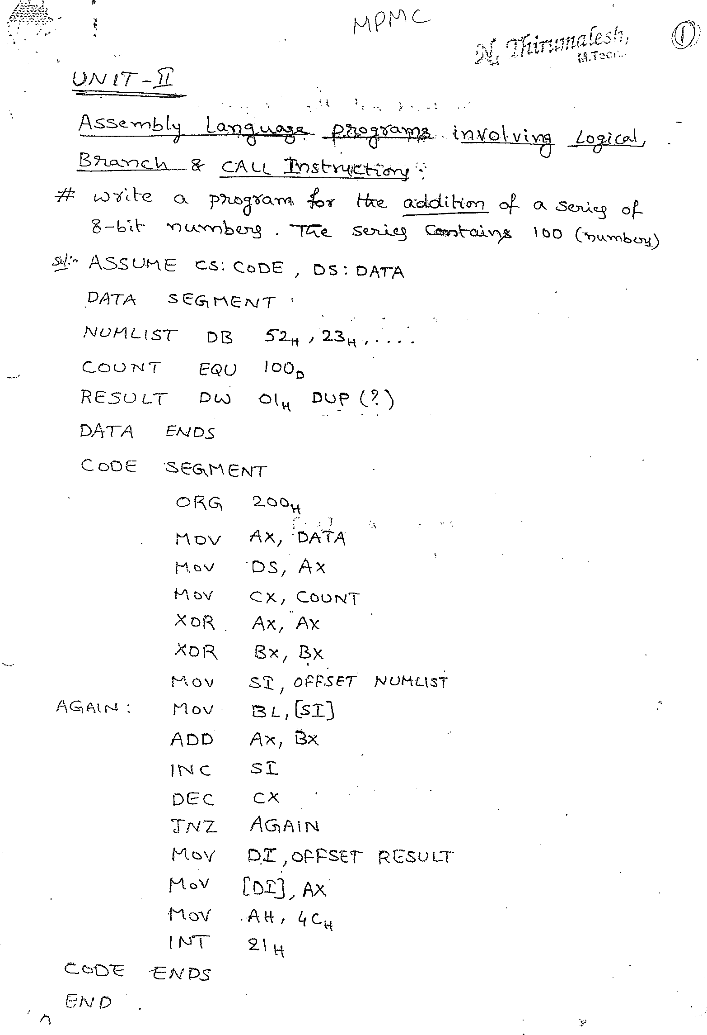

Slide 3
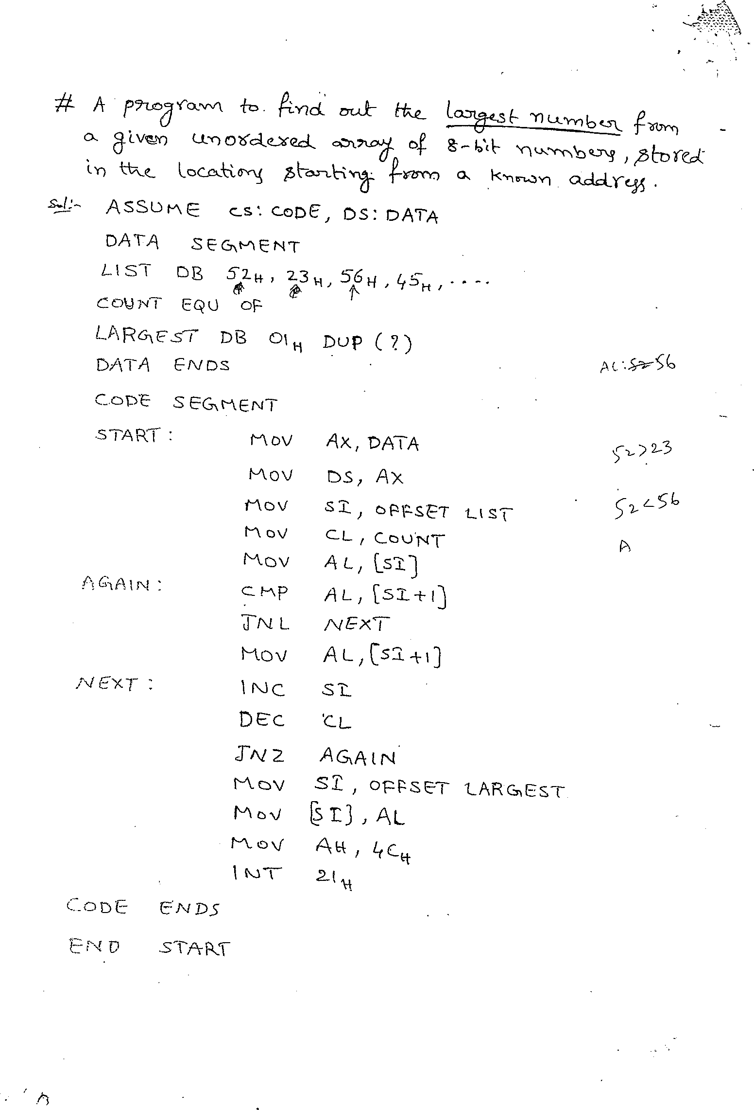

Slide 4
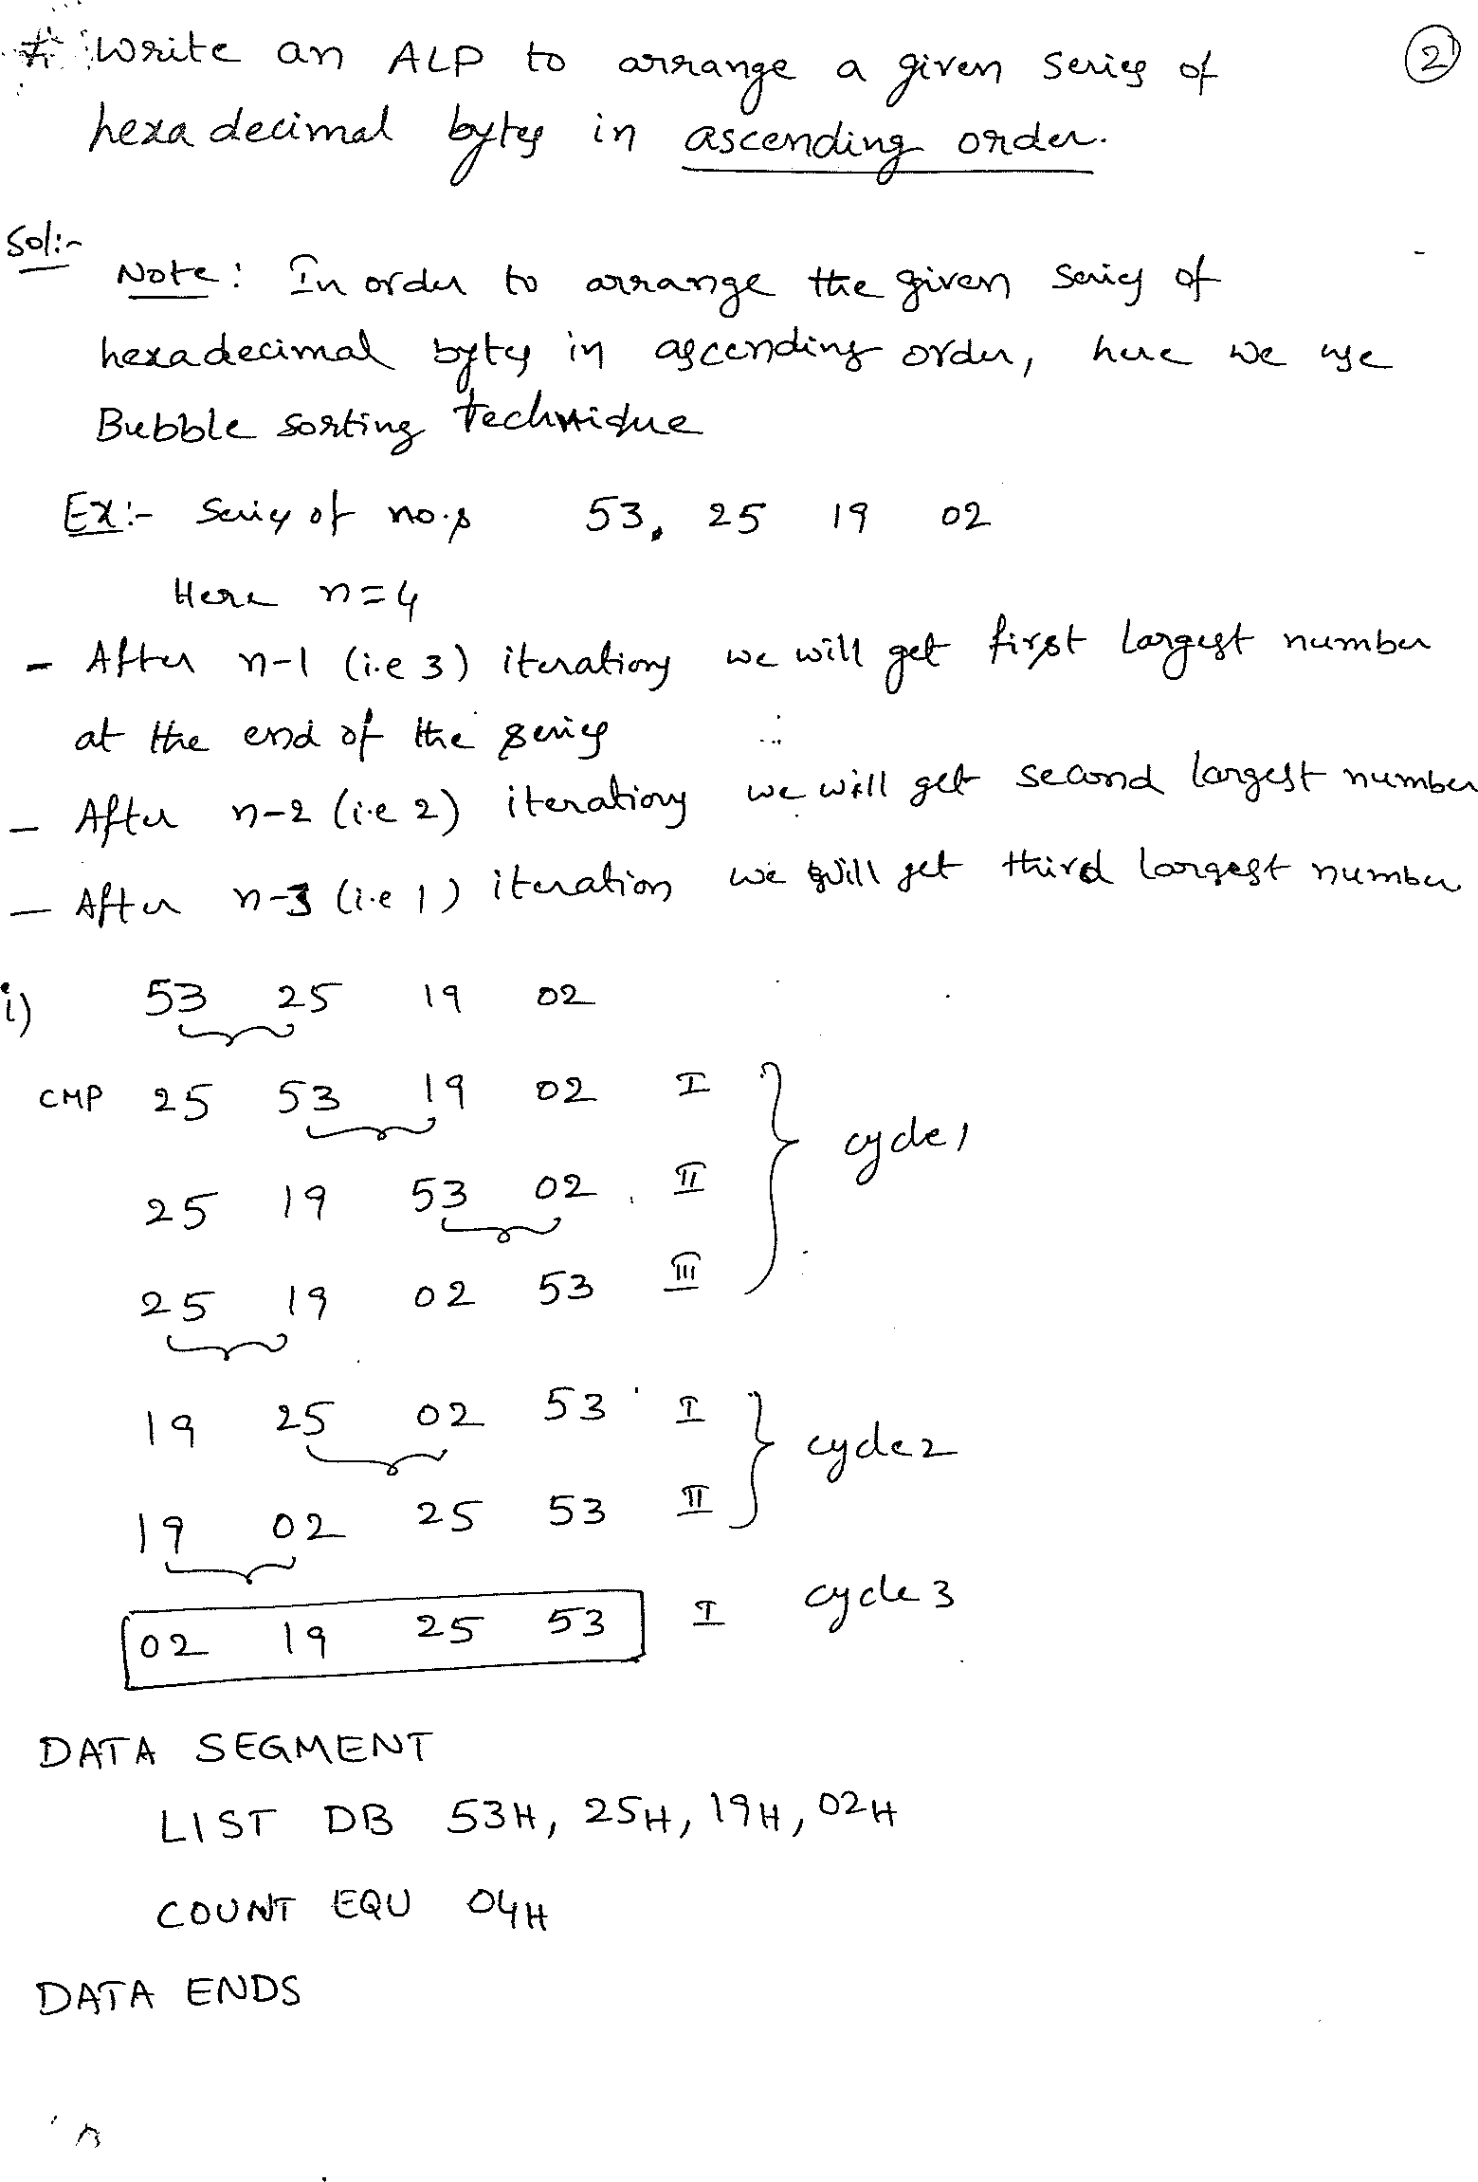

Slide 5
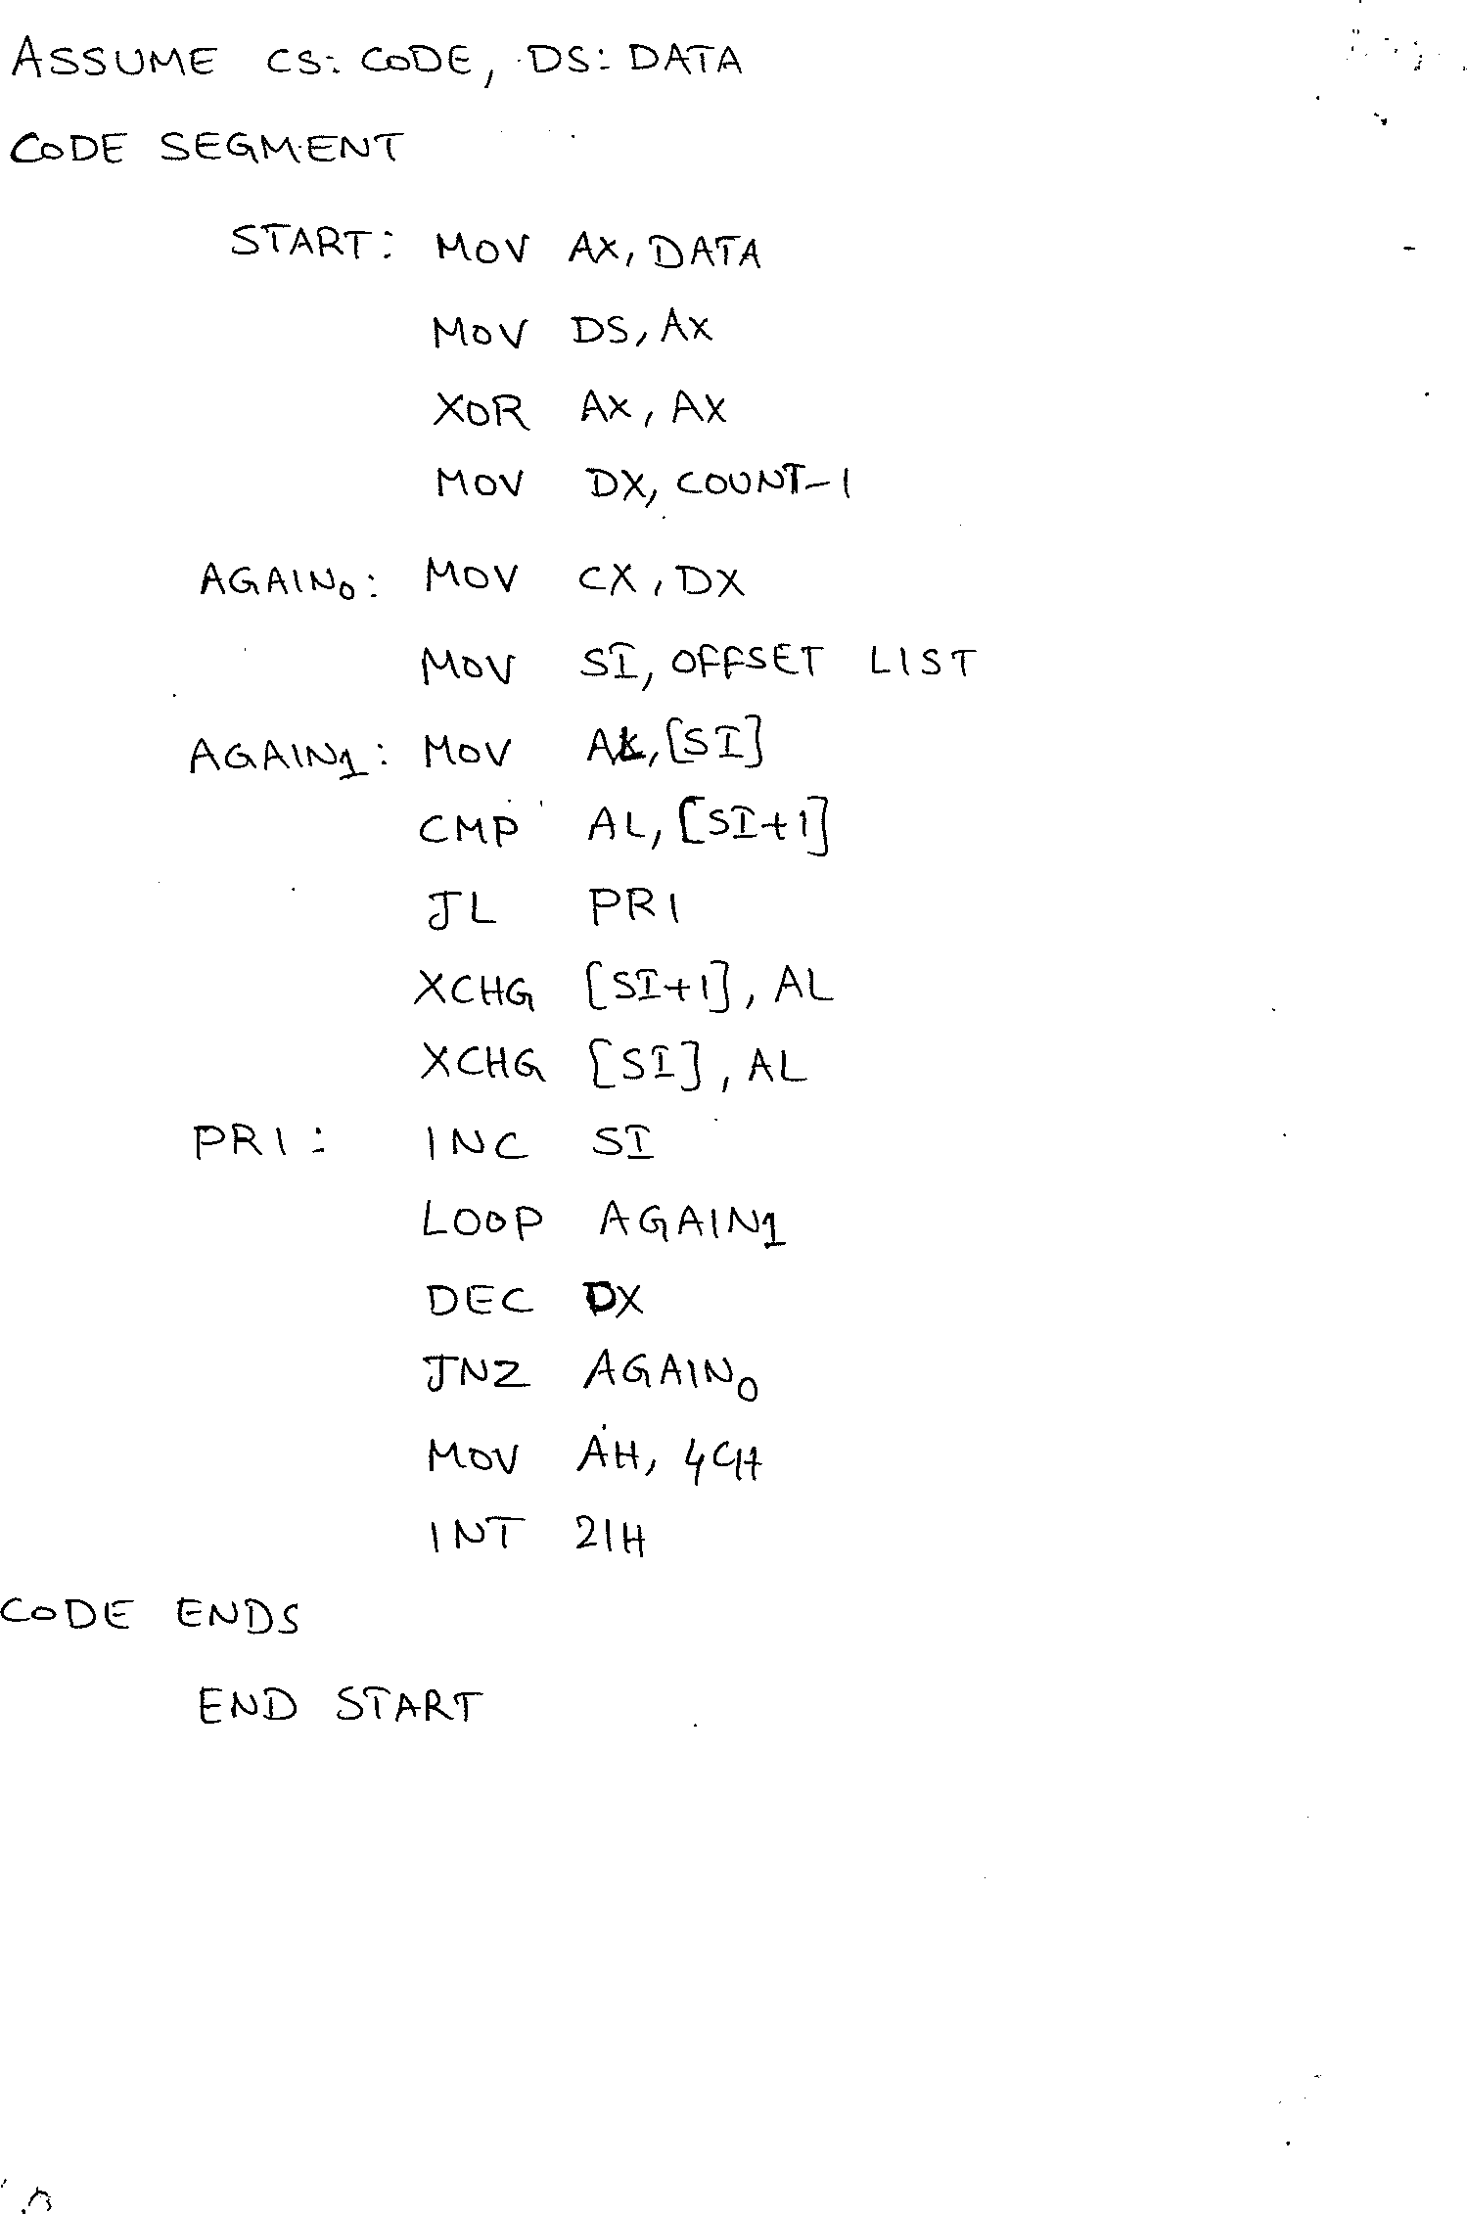

Slide 6
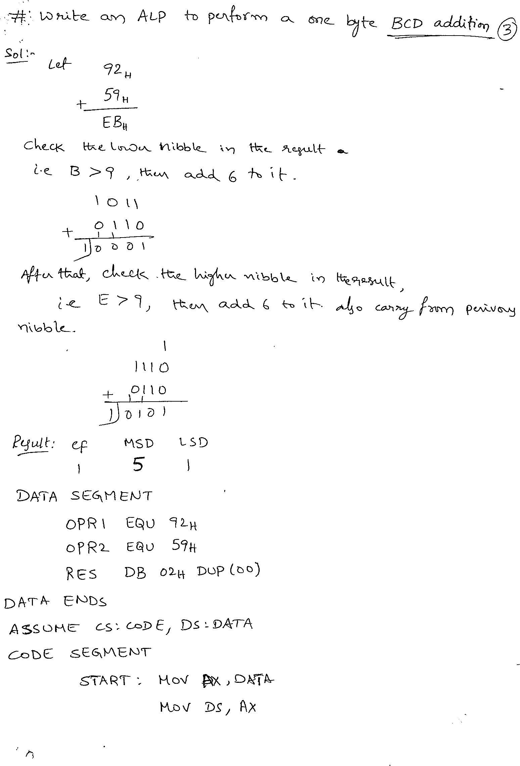

Slide 7
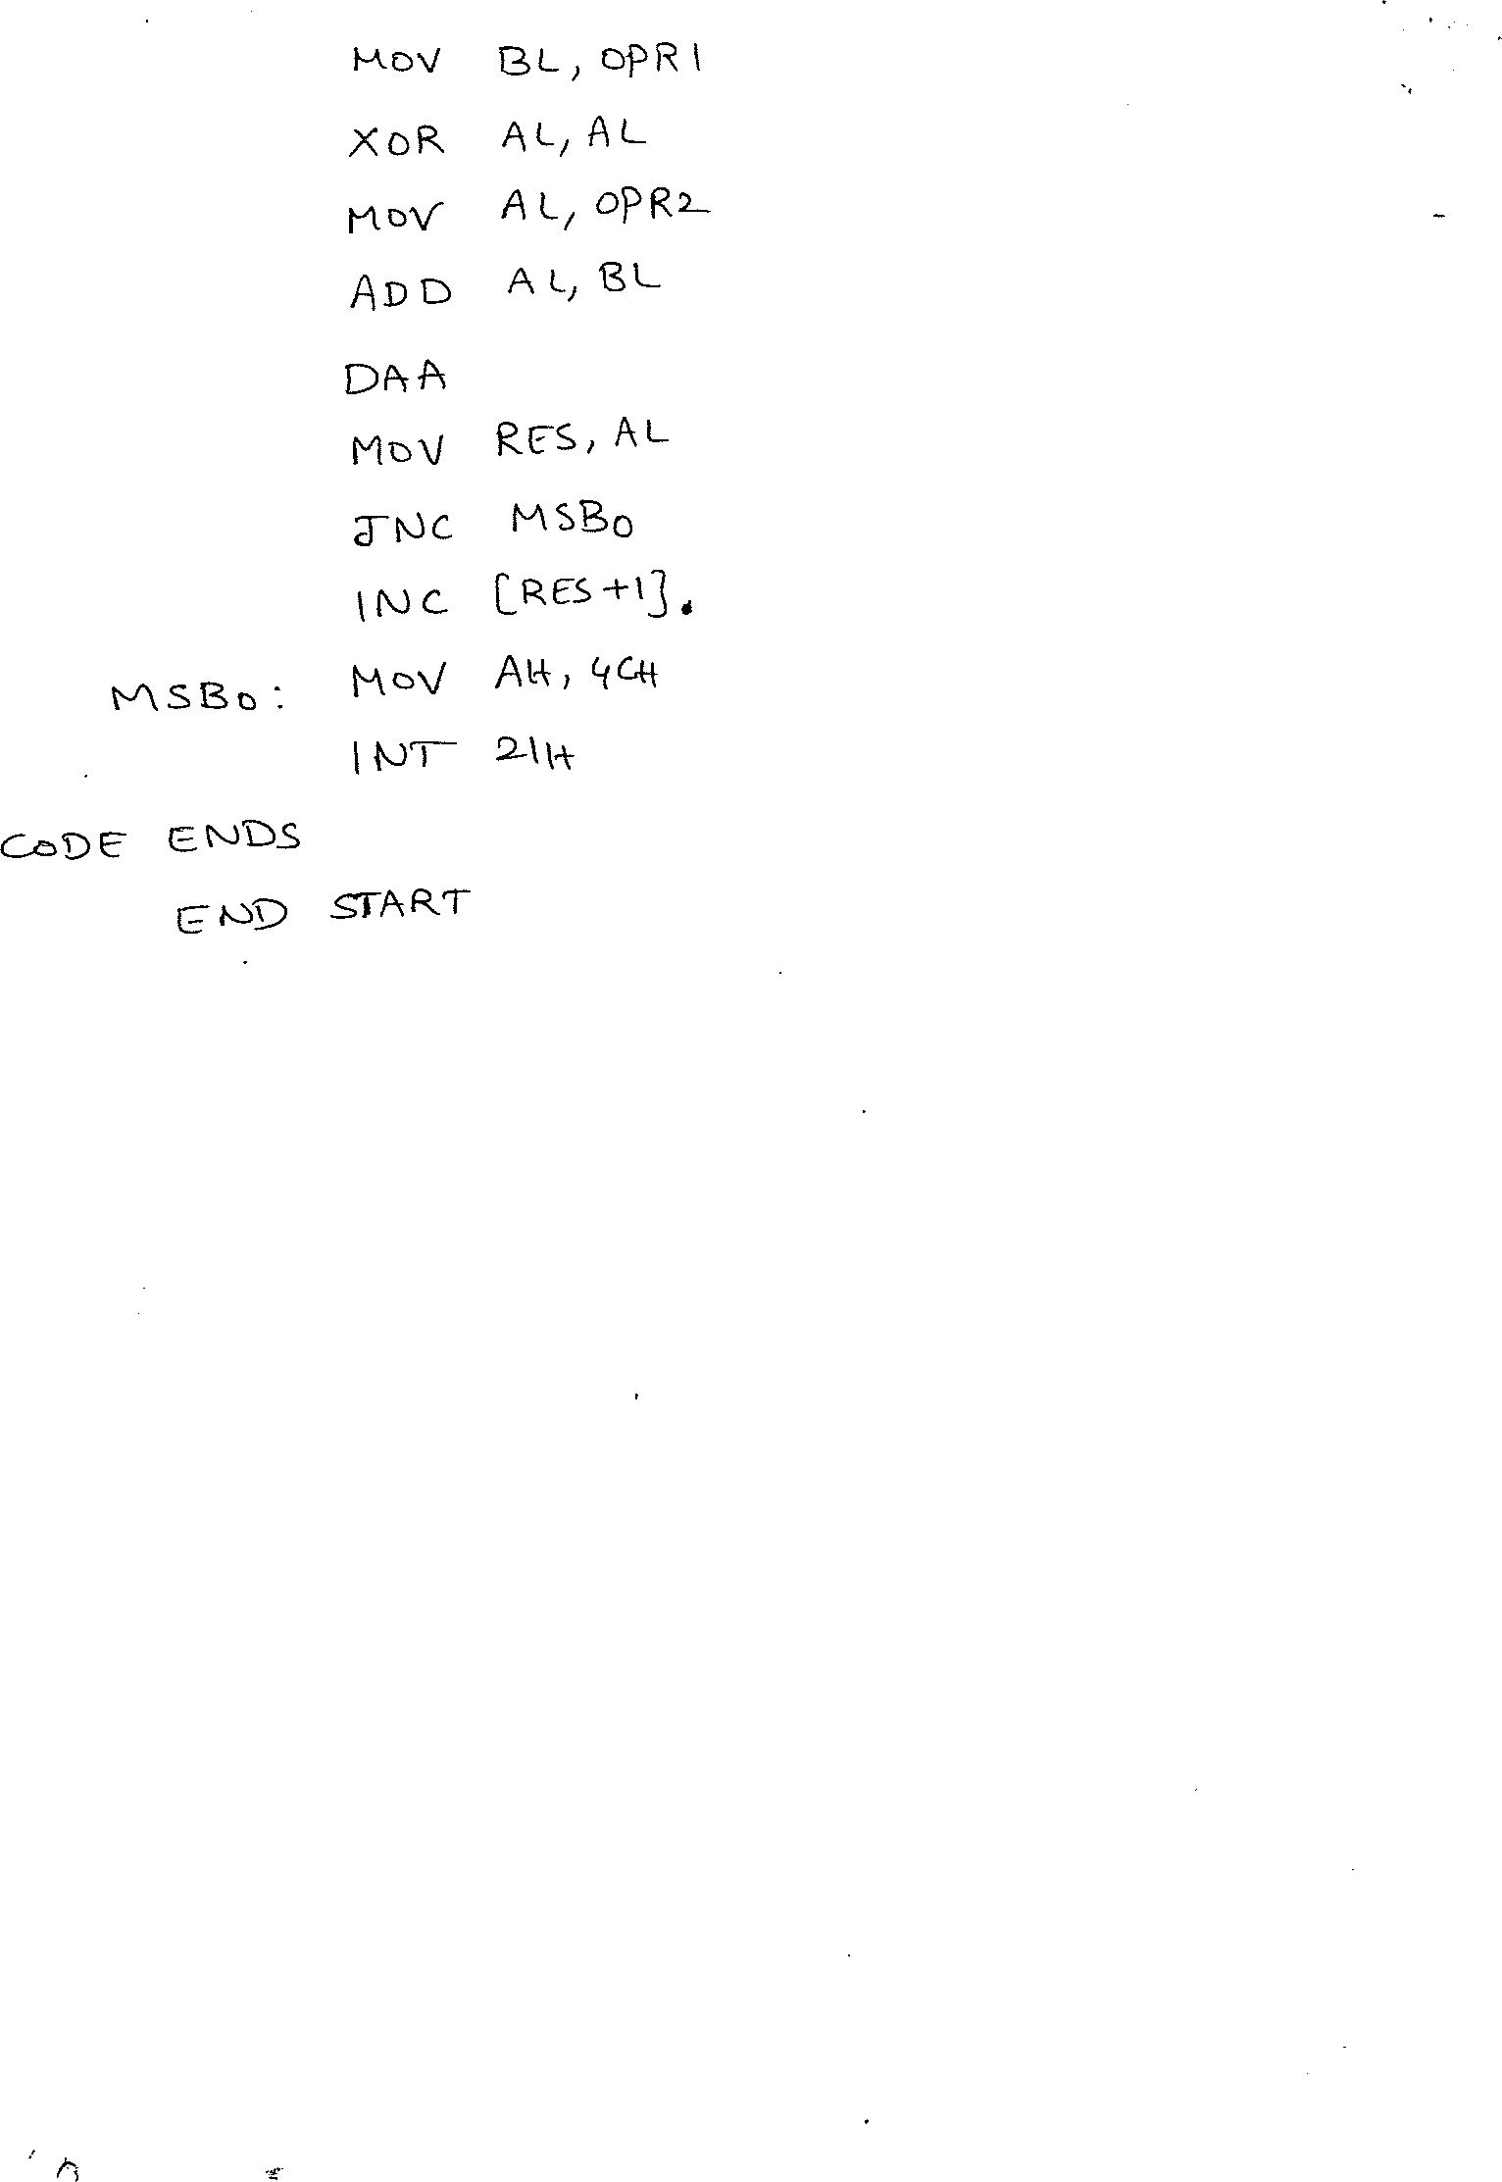

Slide 8
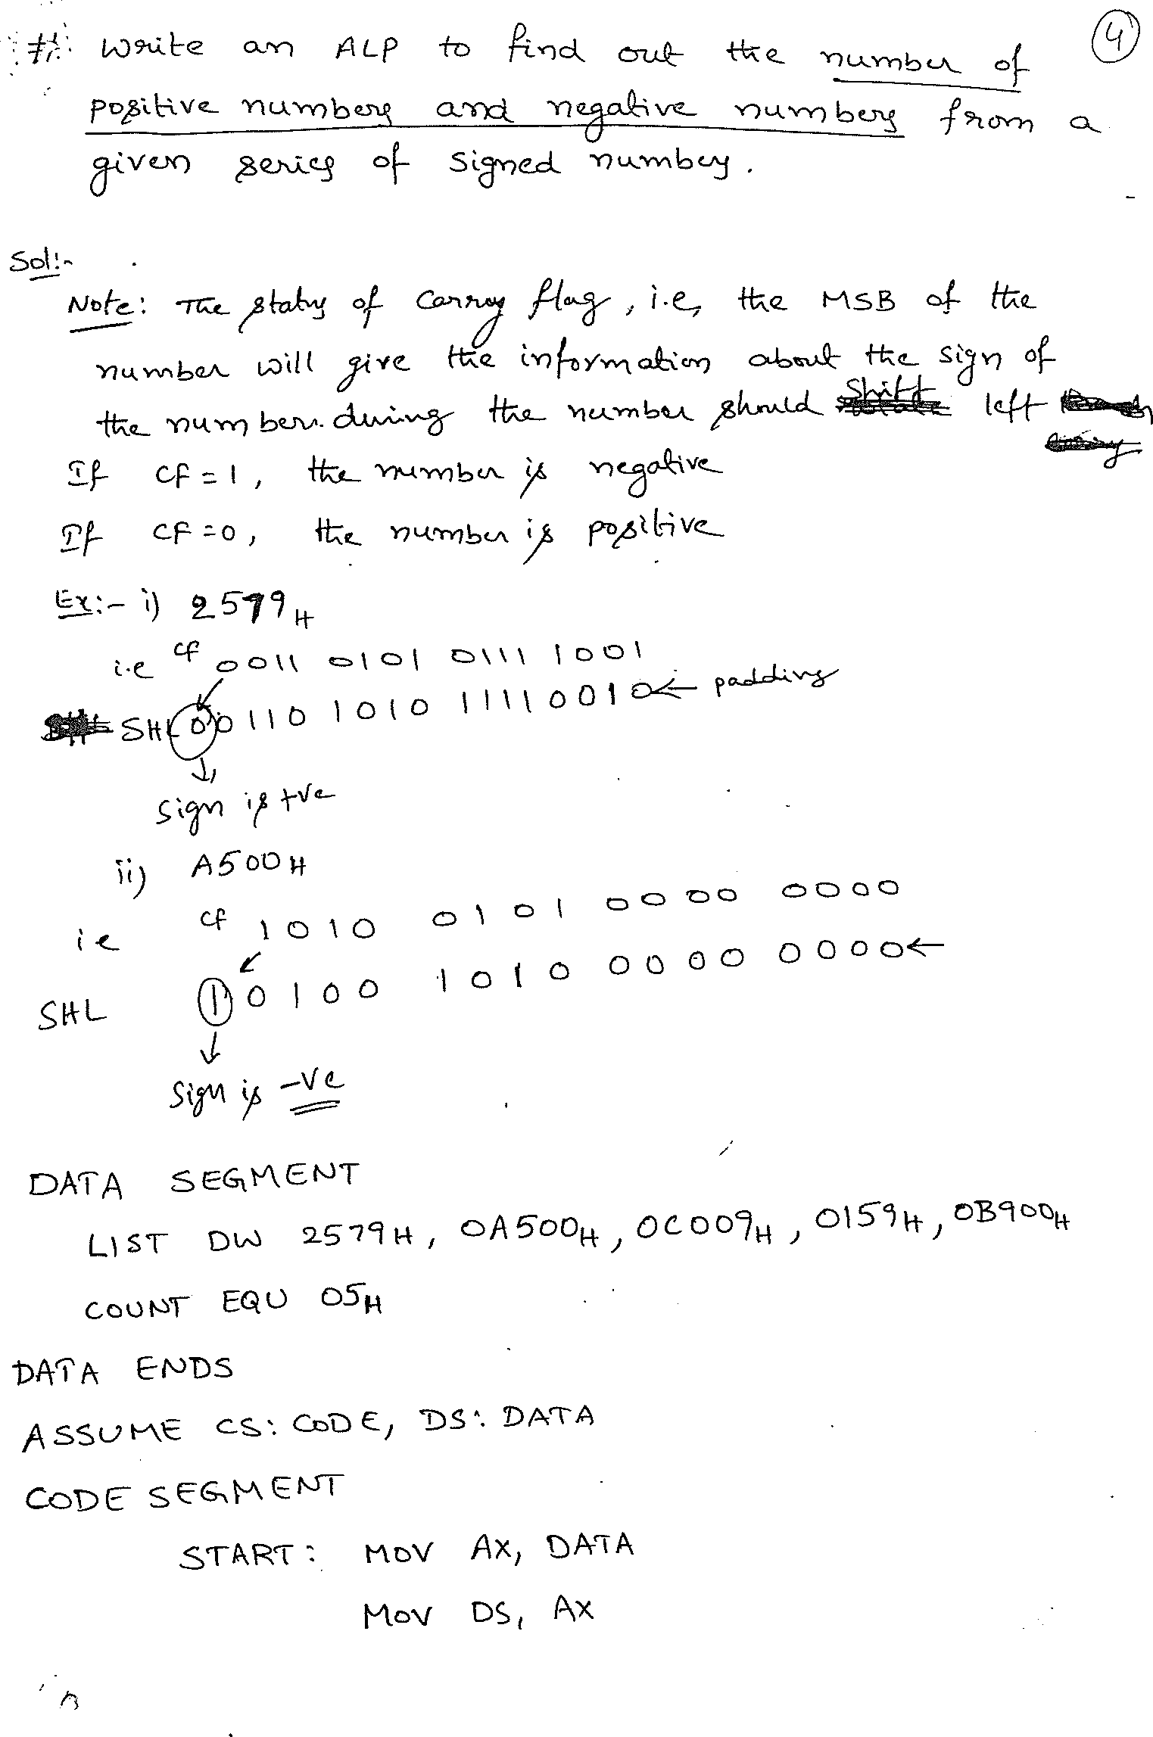

Slide 9
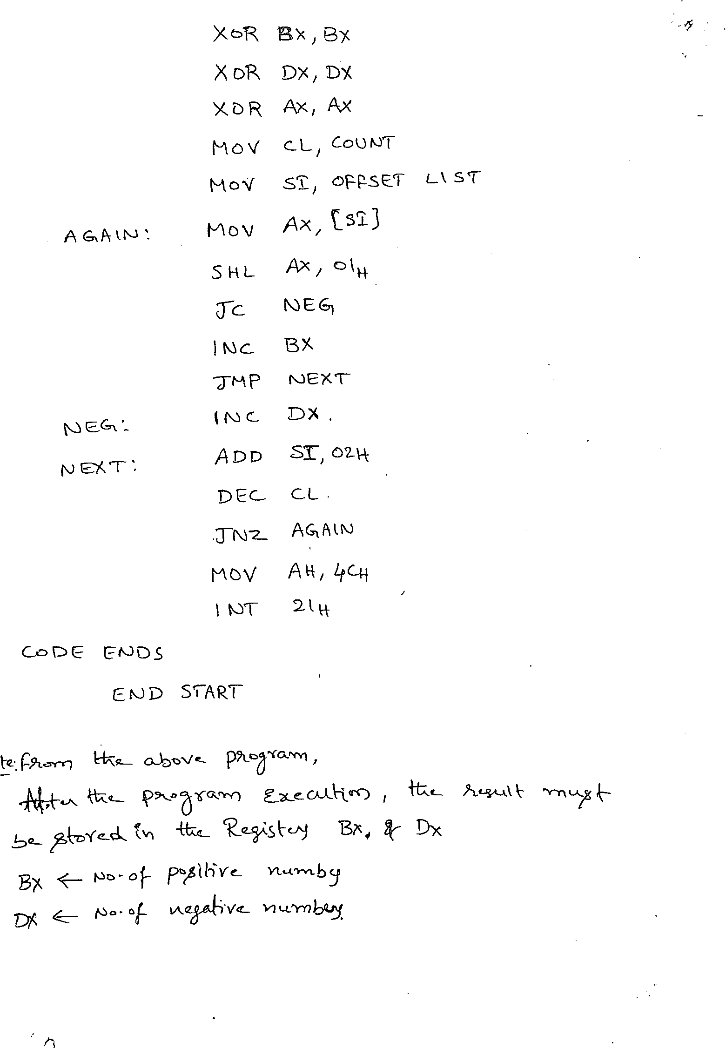

Slide 10
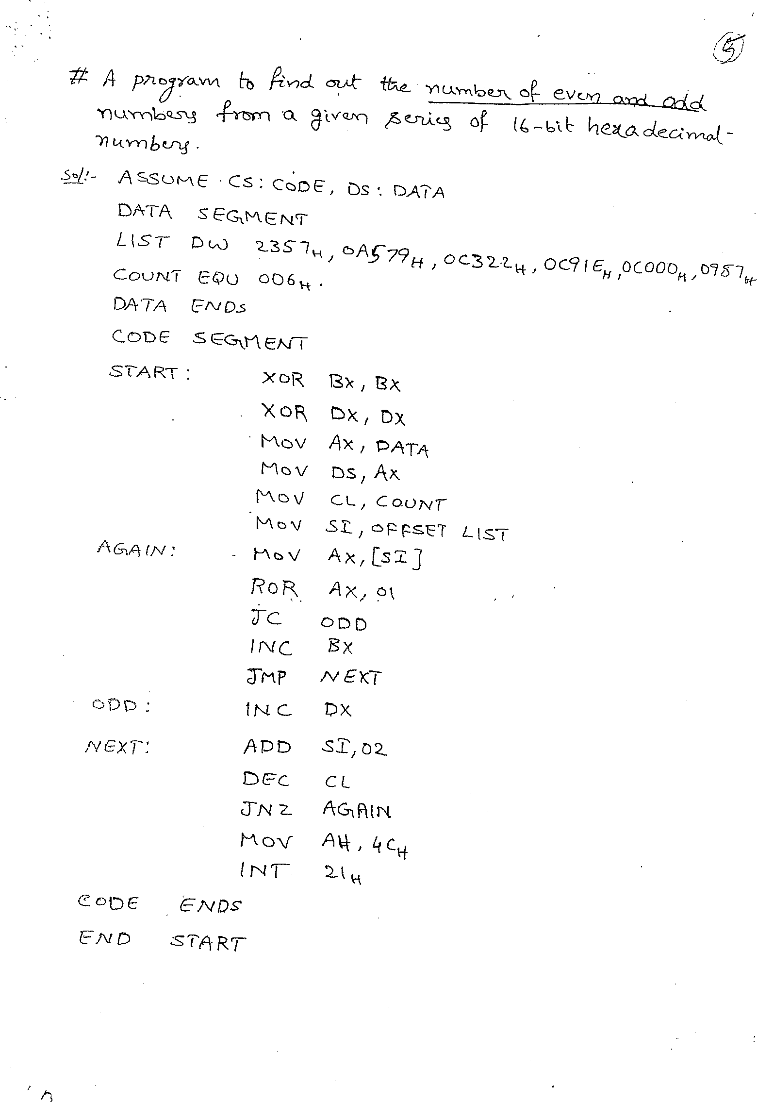

Slide 11
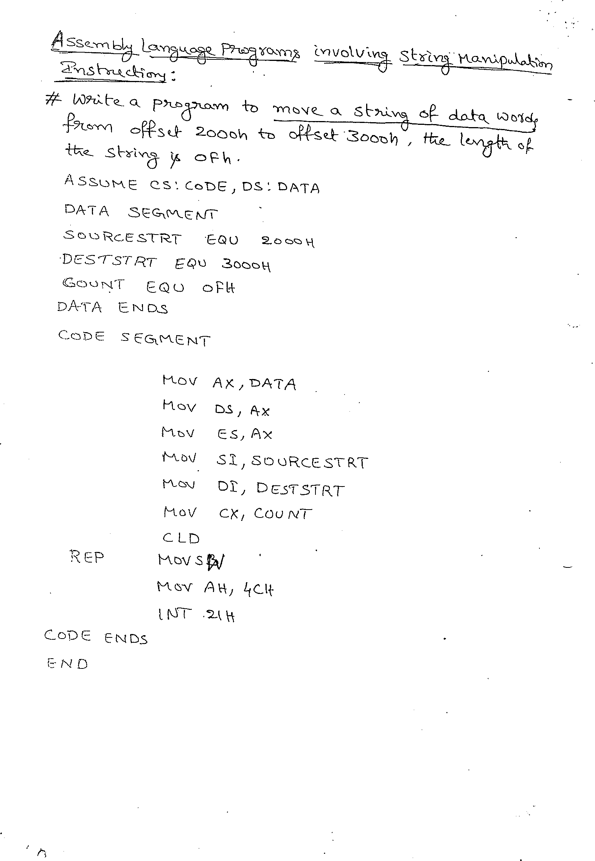

Slide 12
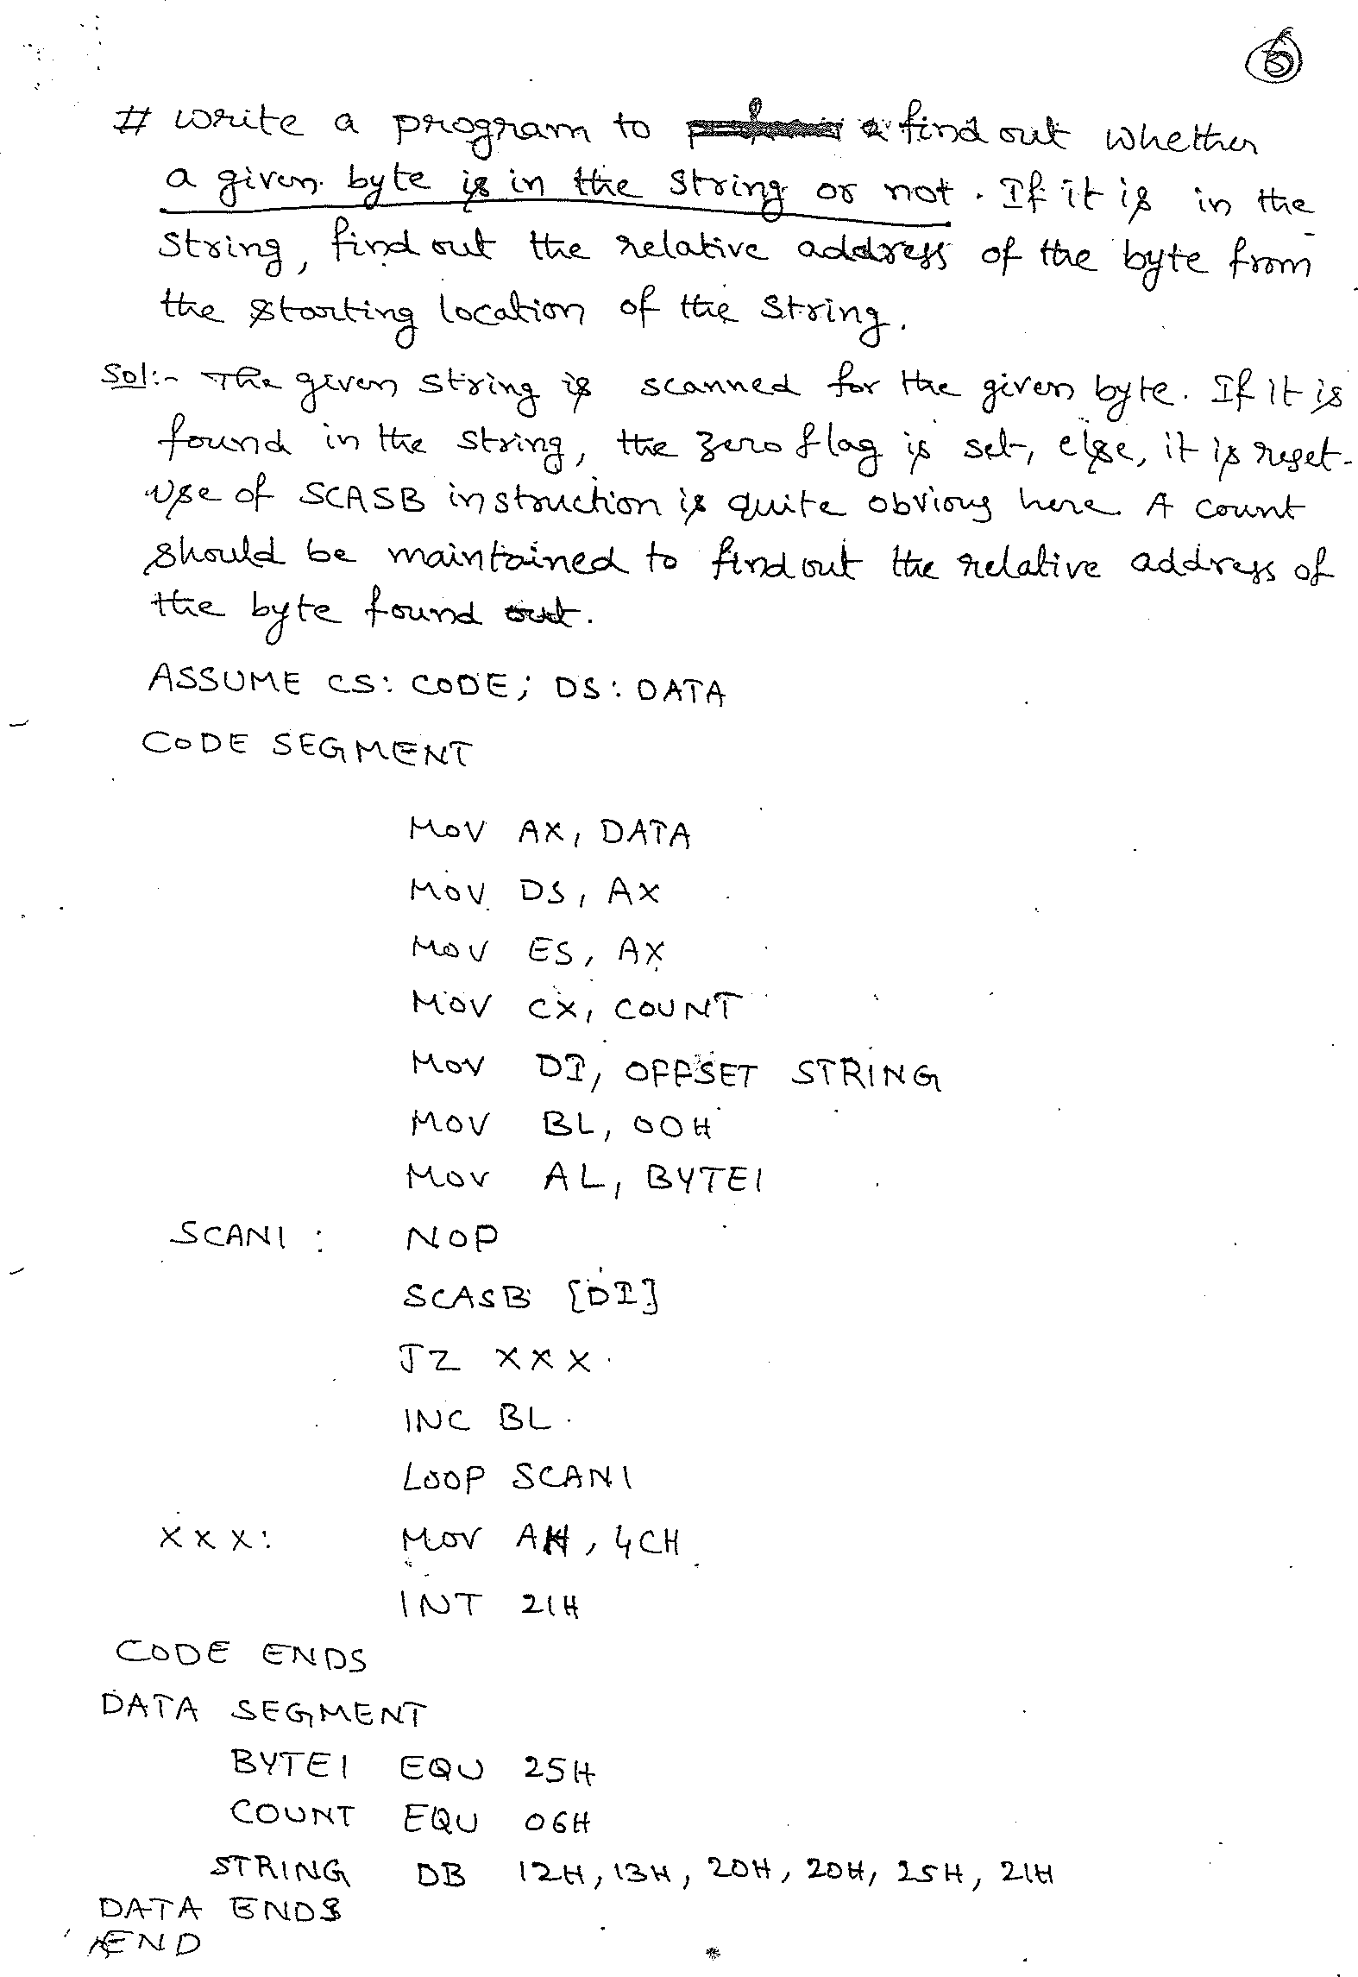
m

Slide 13
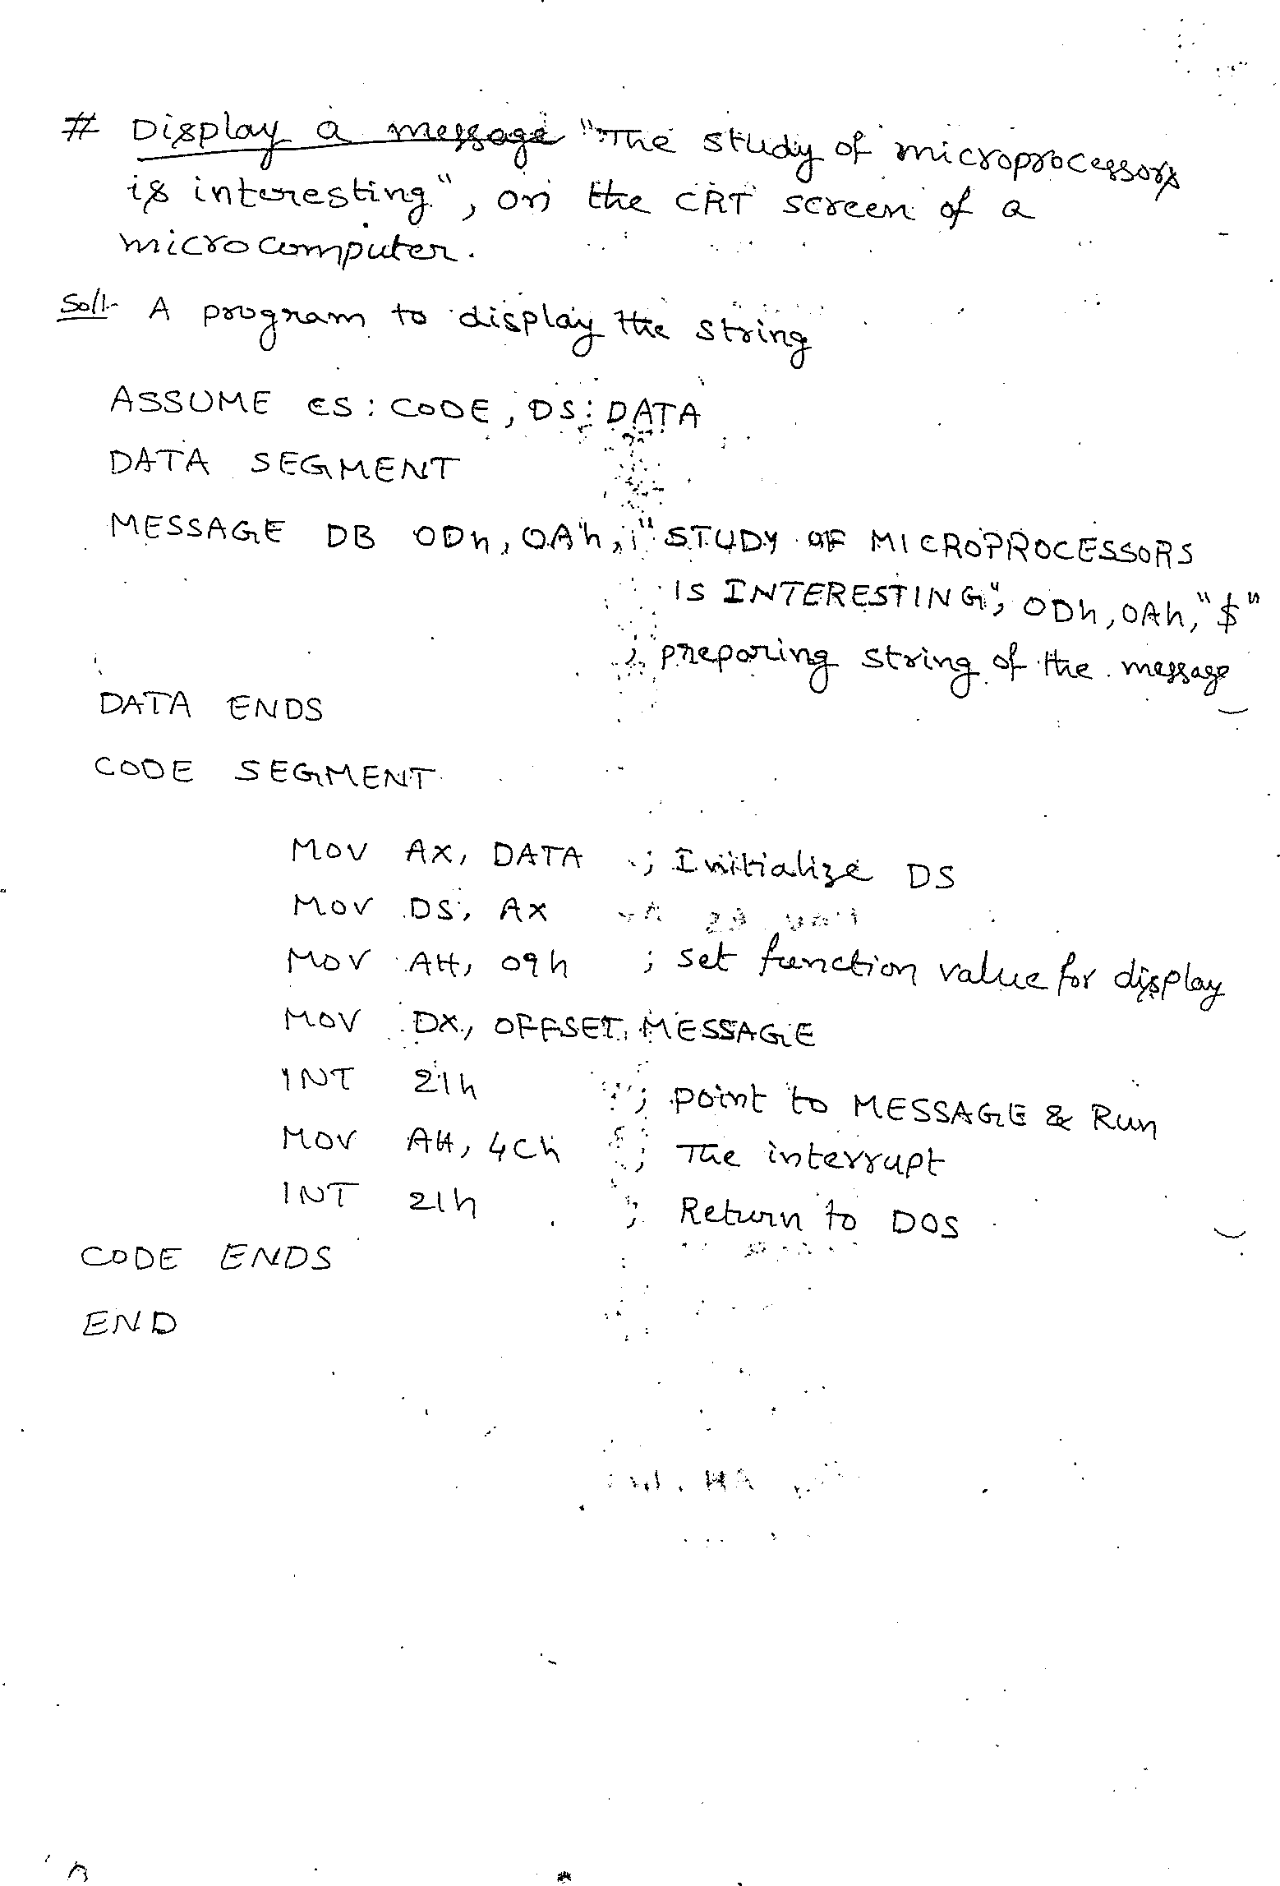
m

Slide 14
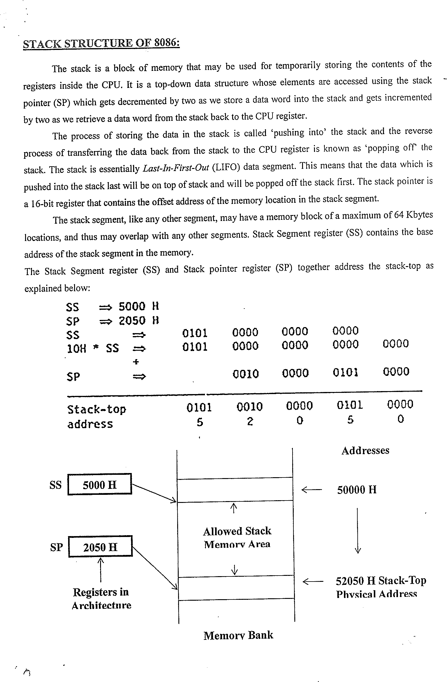

Slide 15
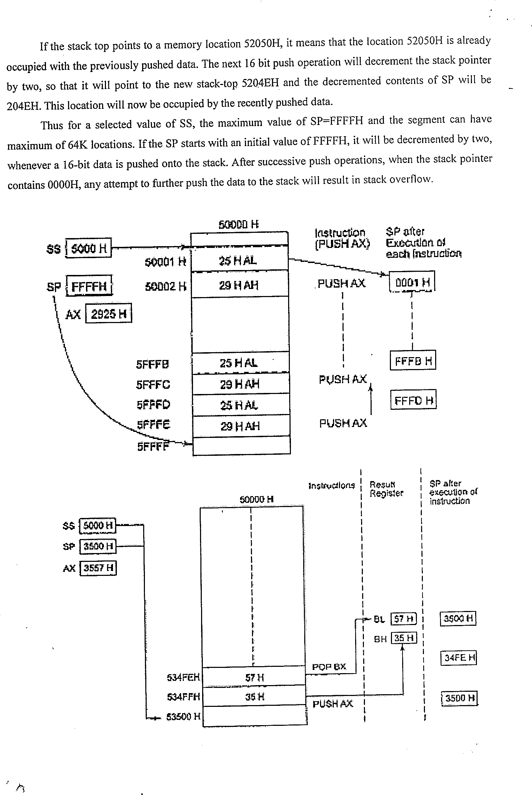

Slide 16
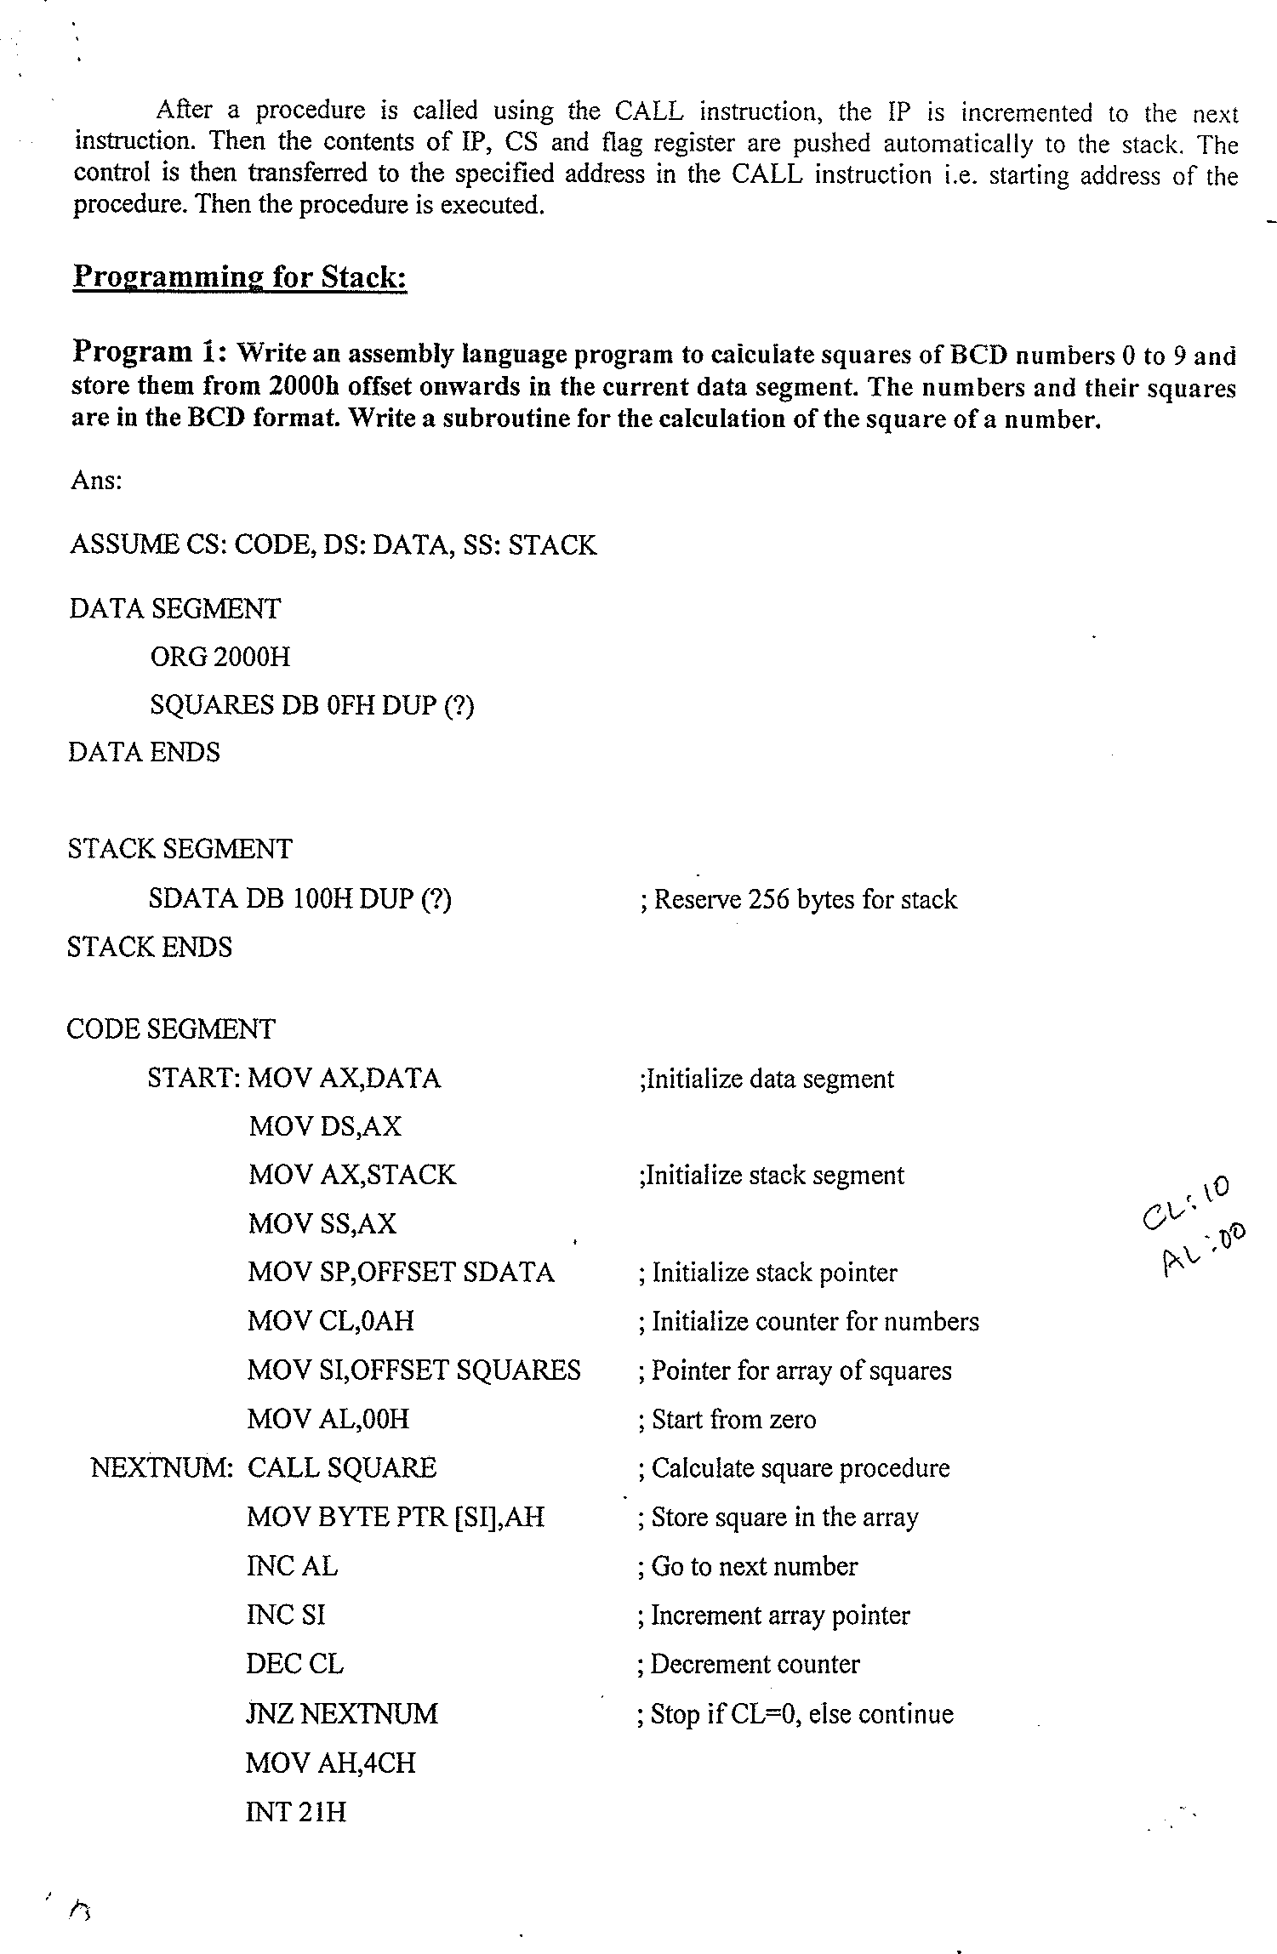

Slide 17
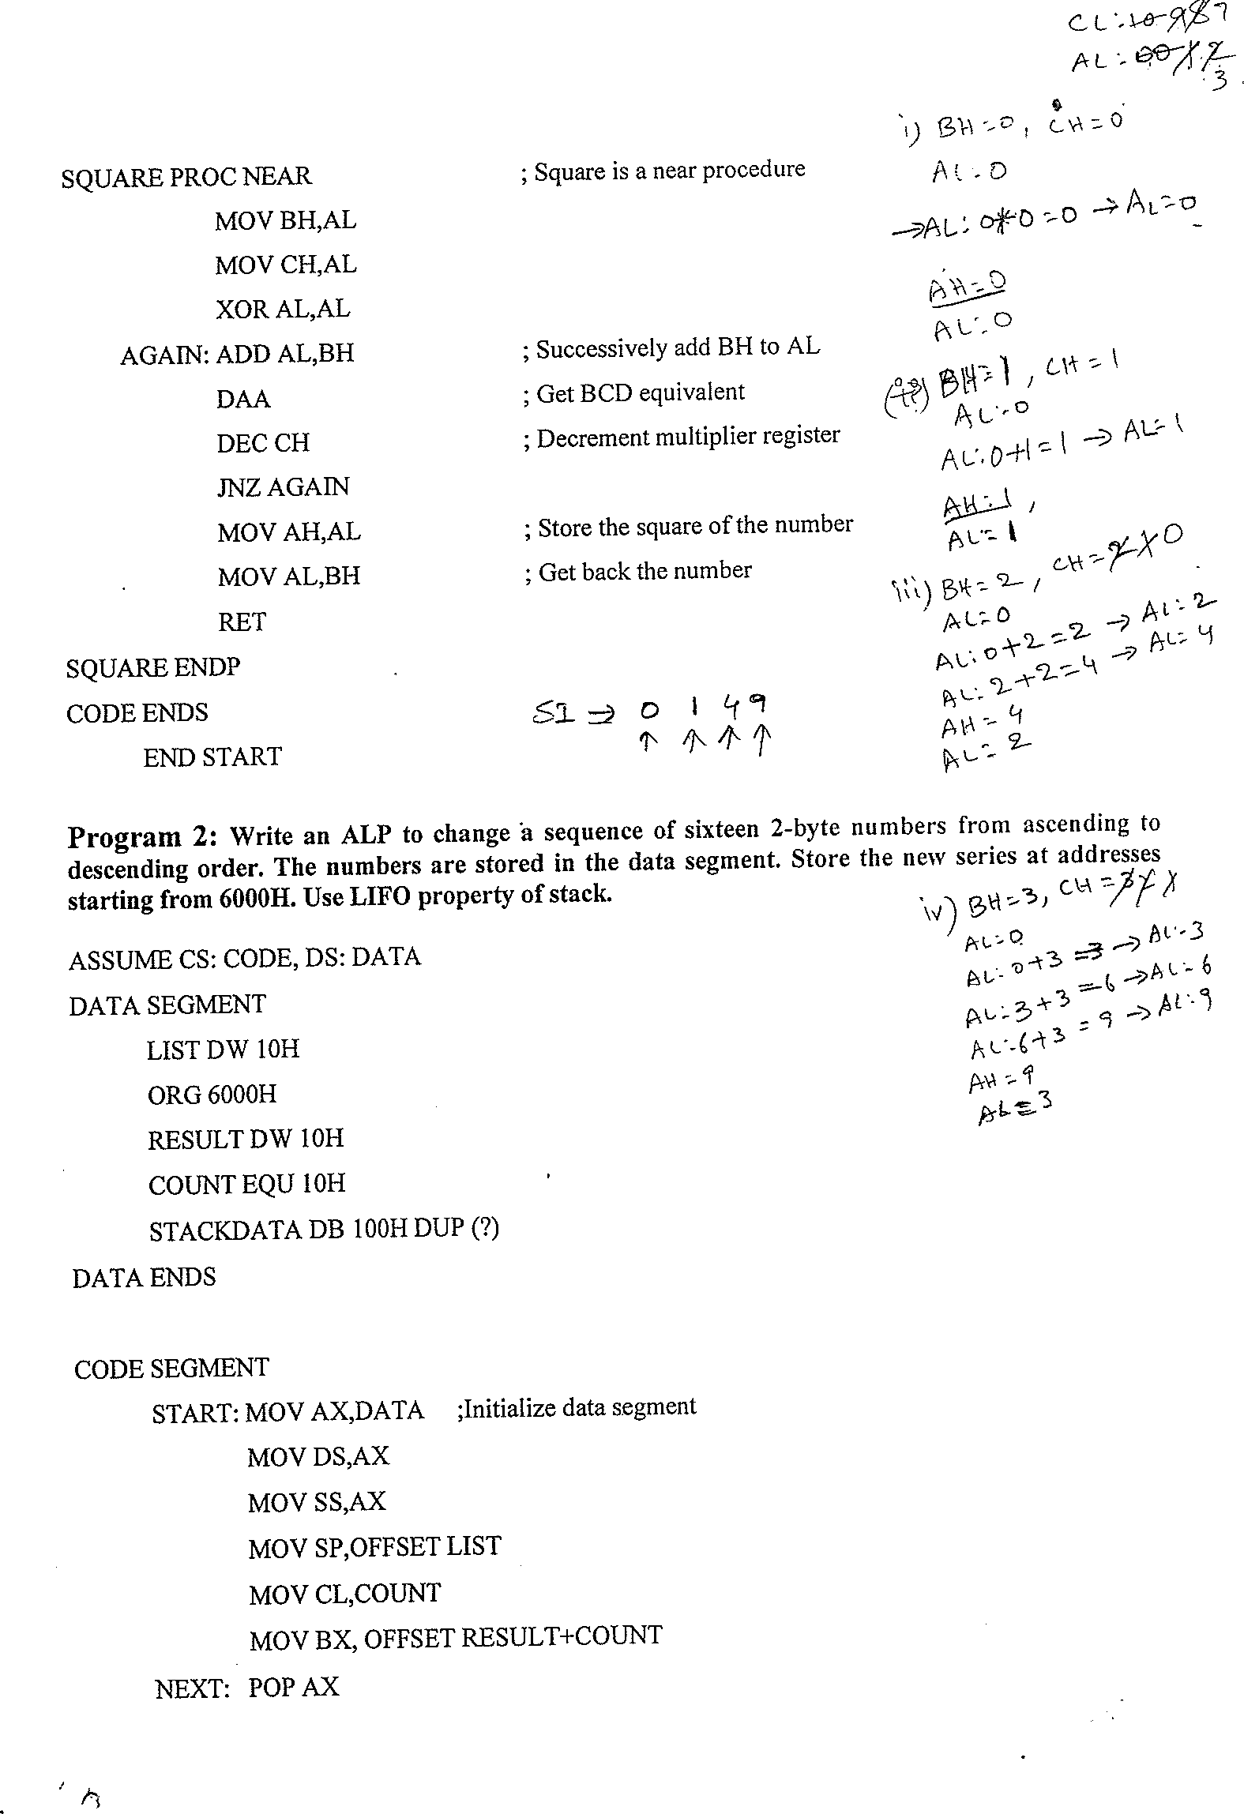

Slide 18
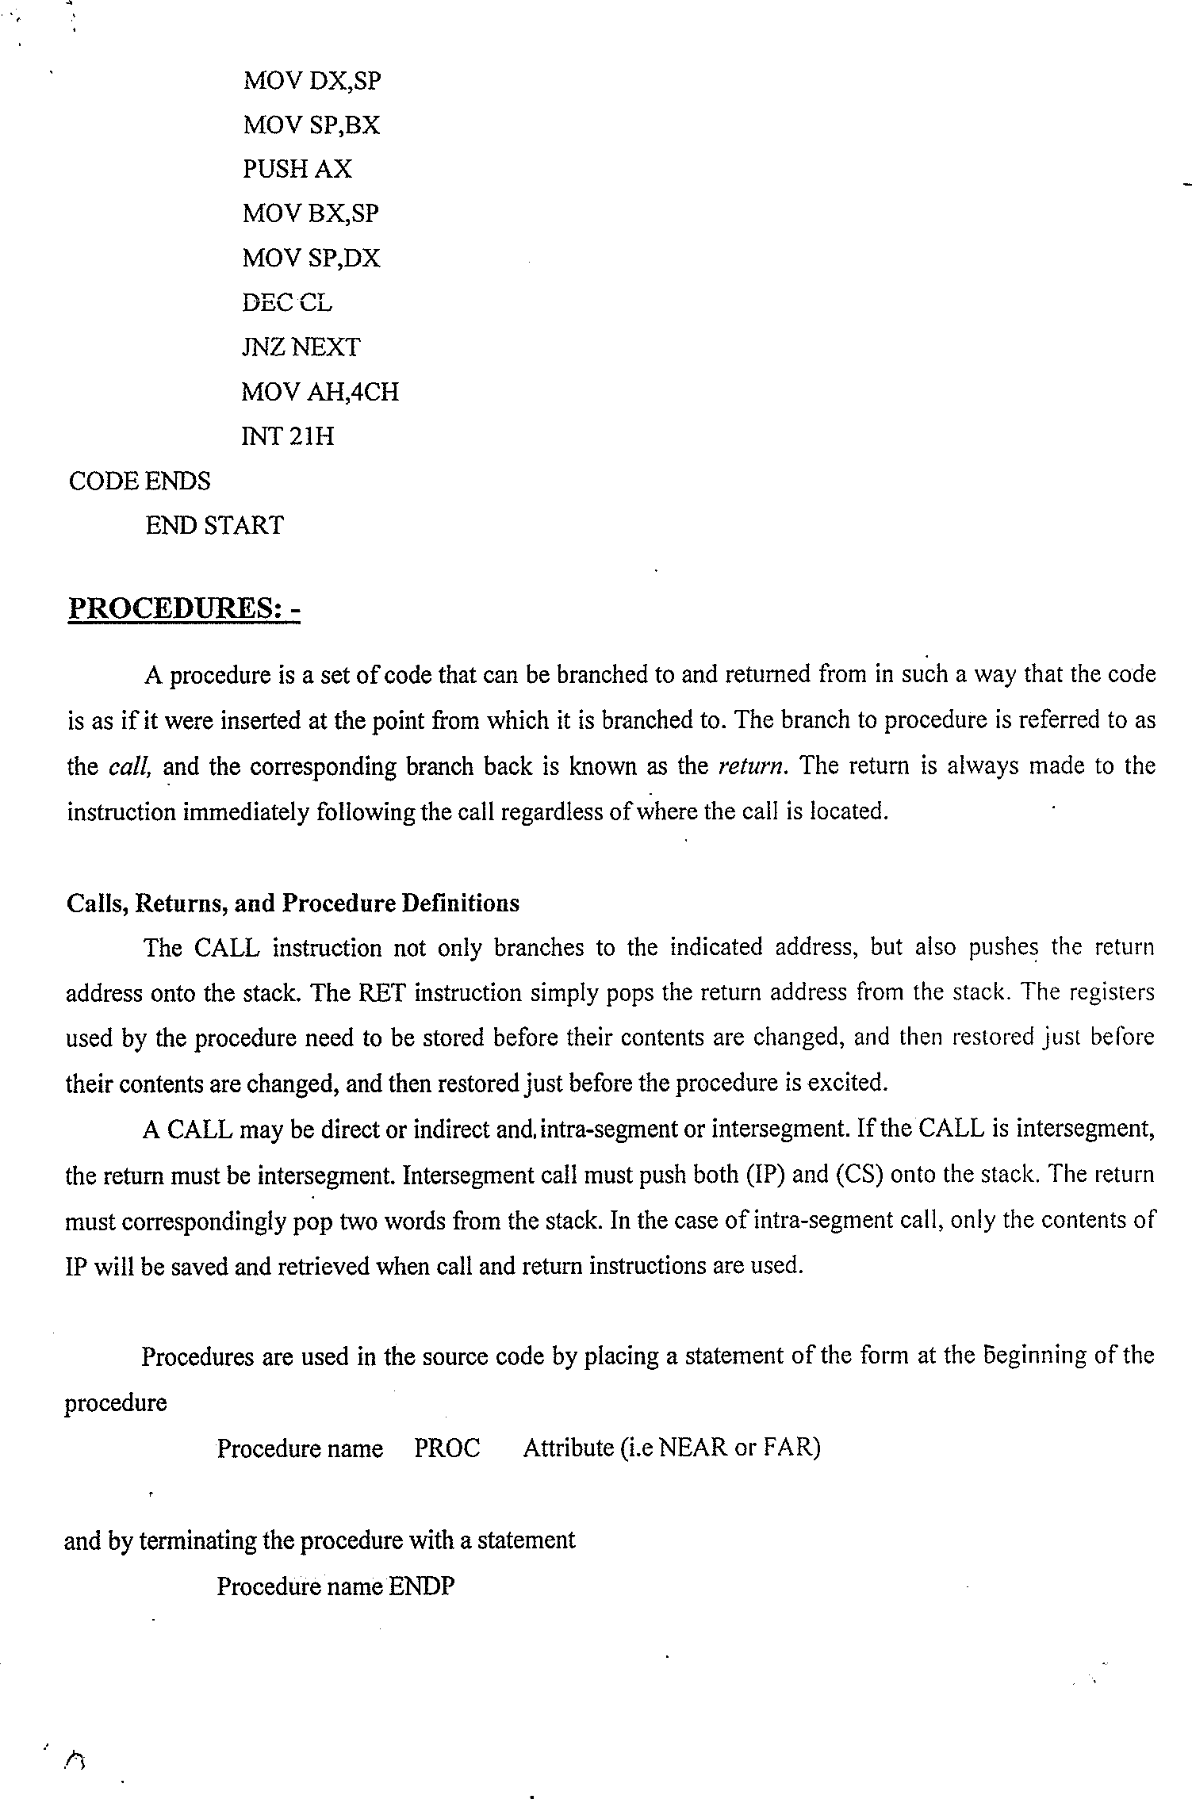

Slide 19
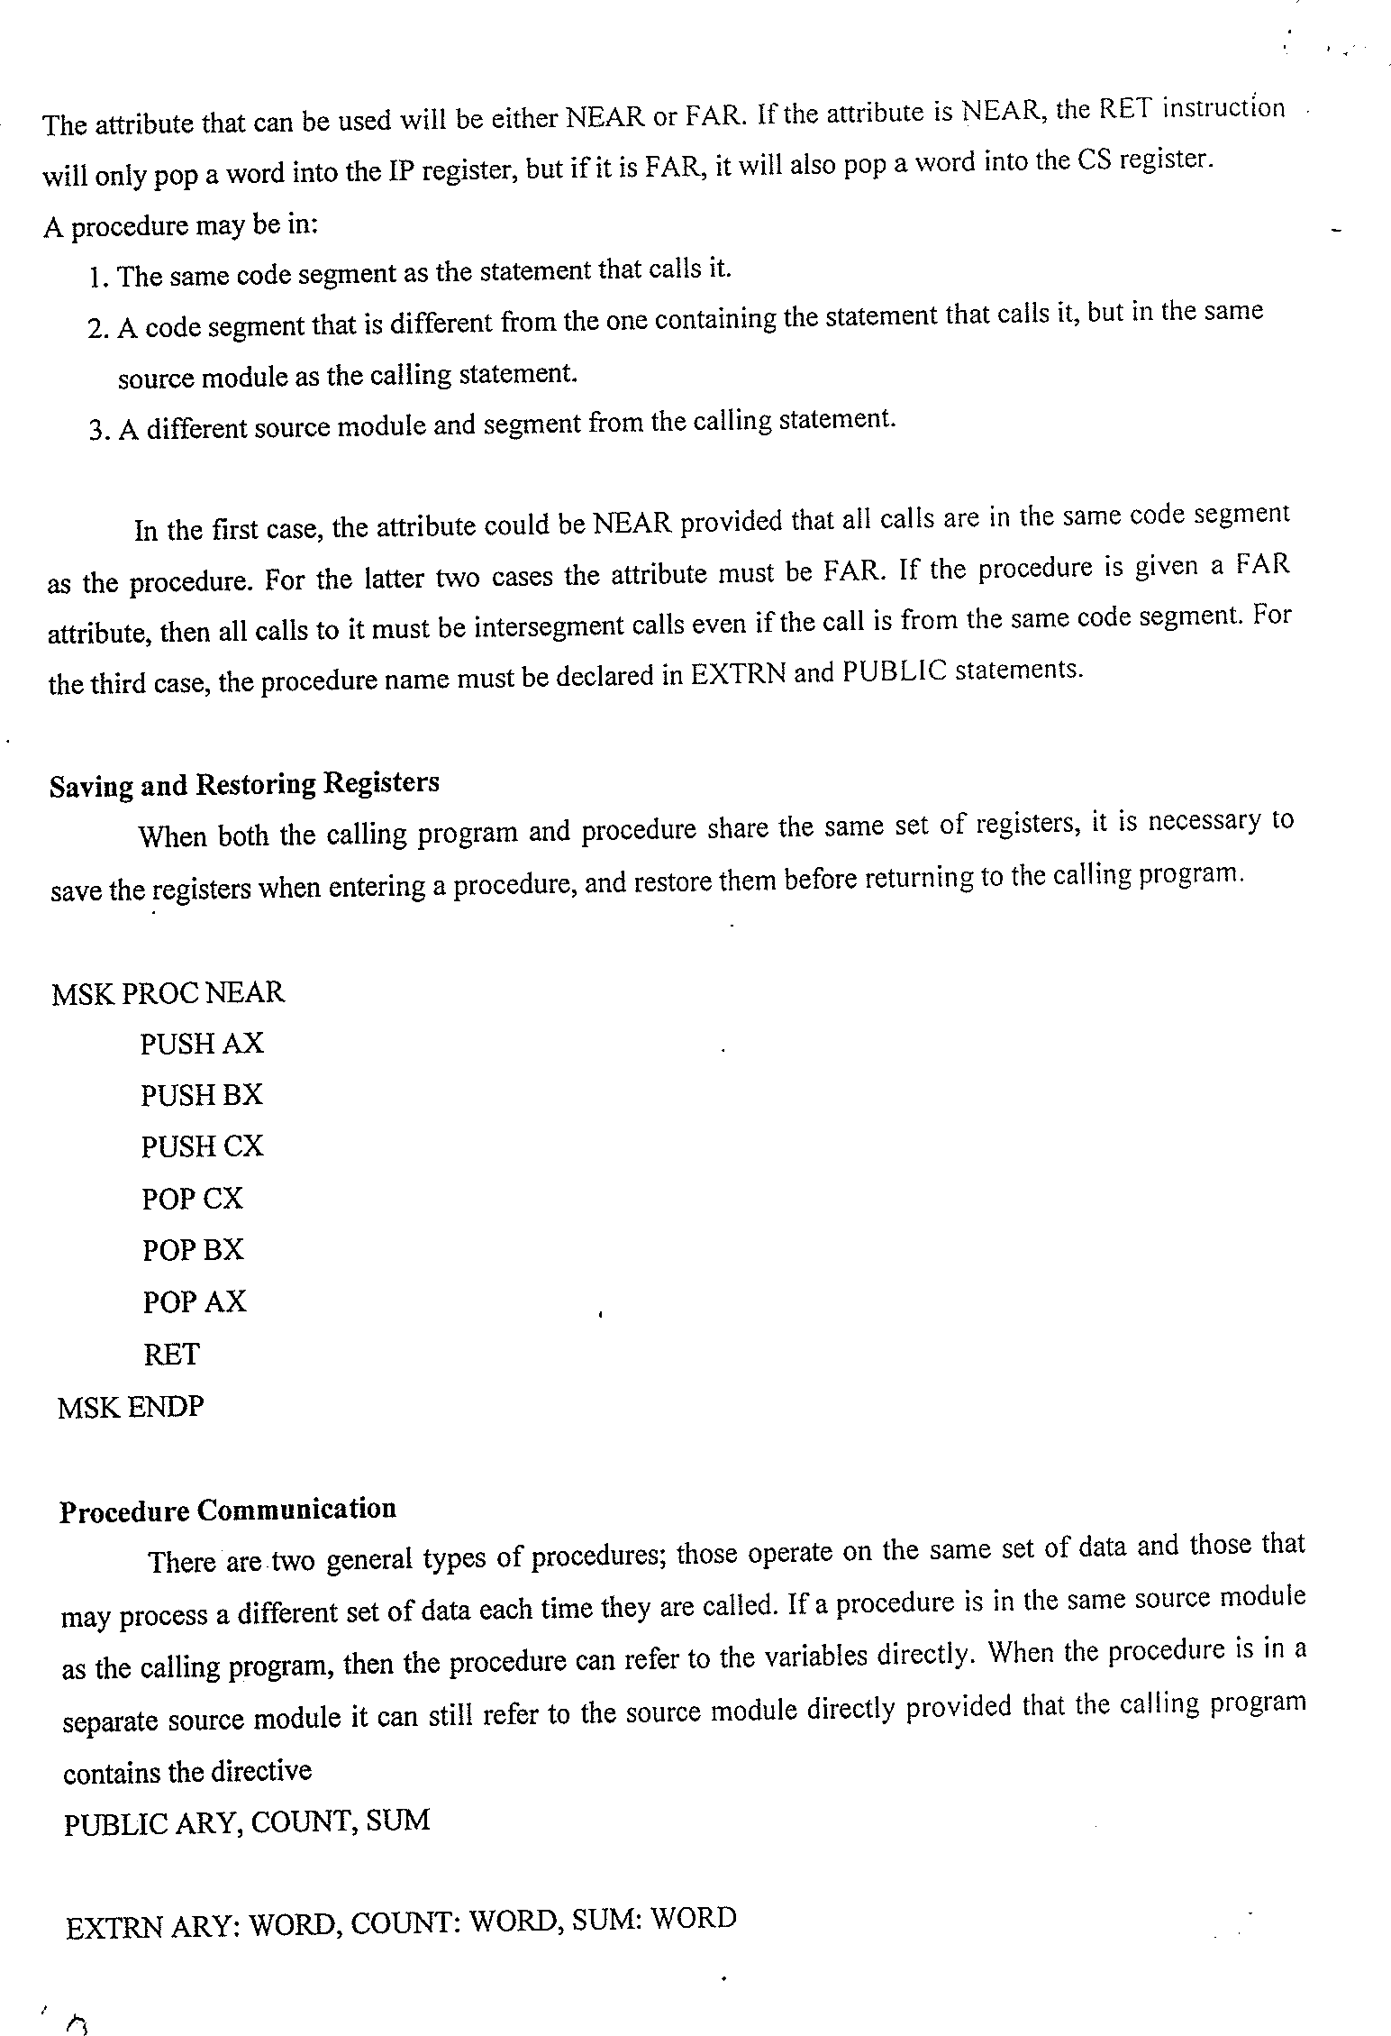

Slide 20
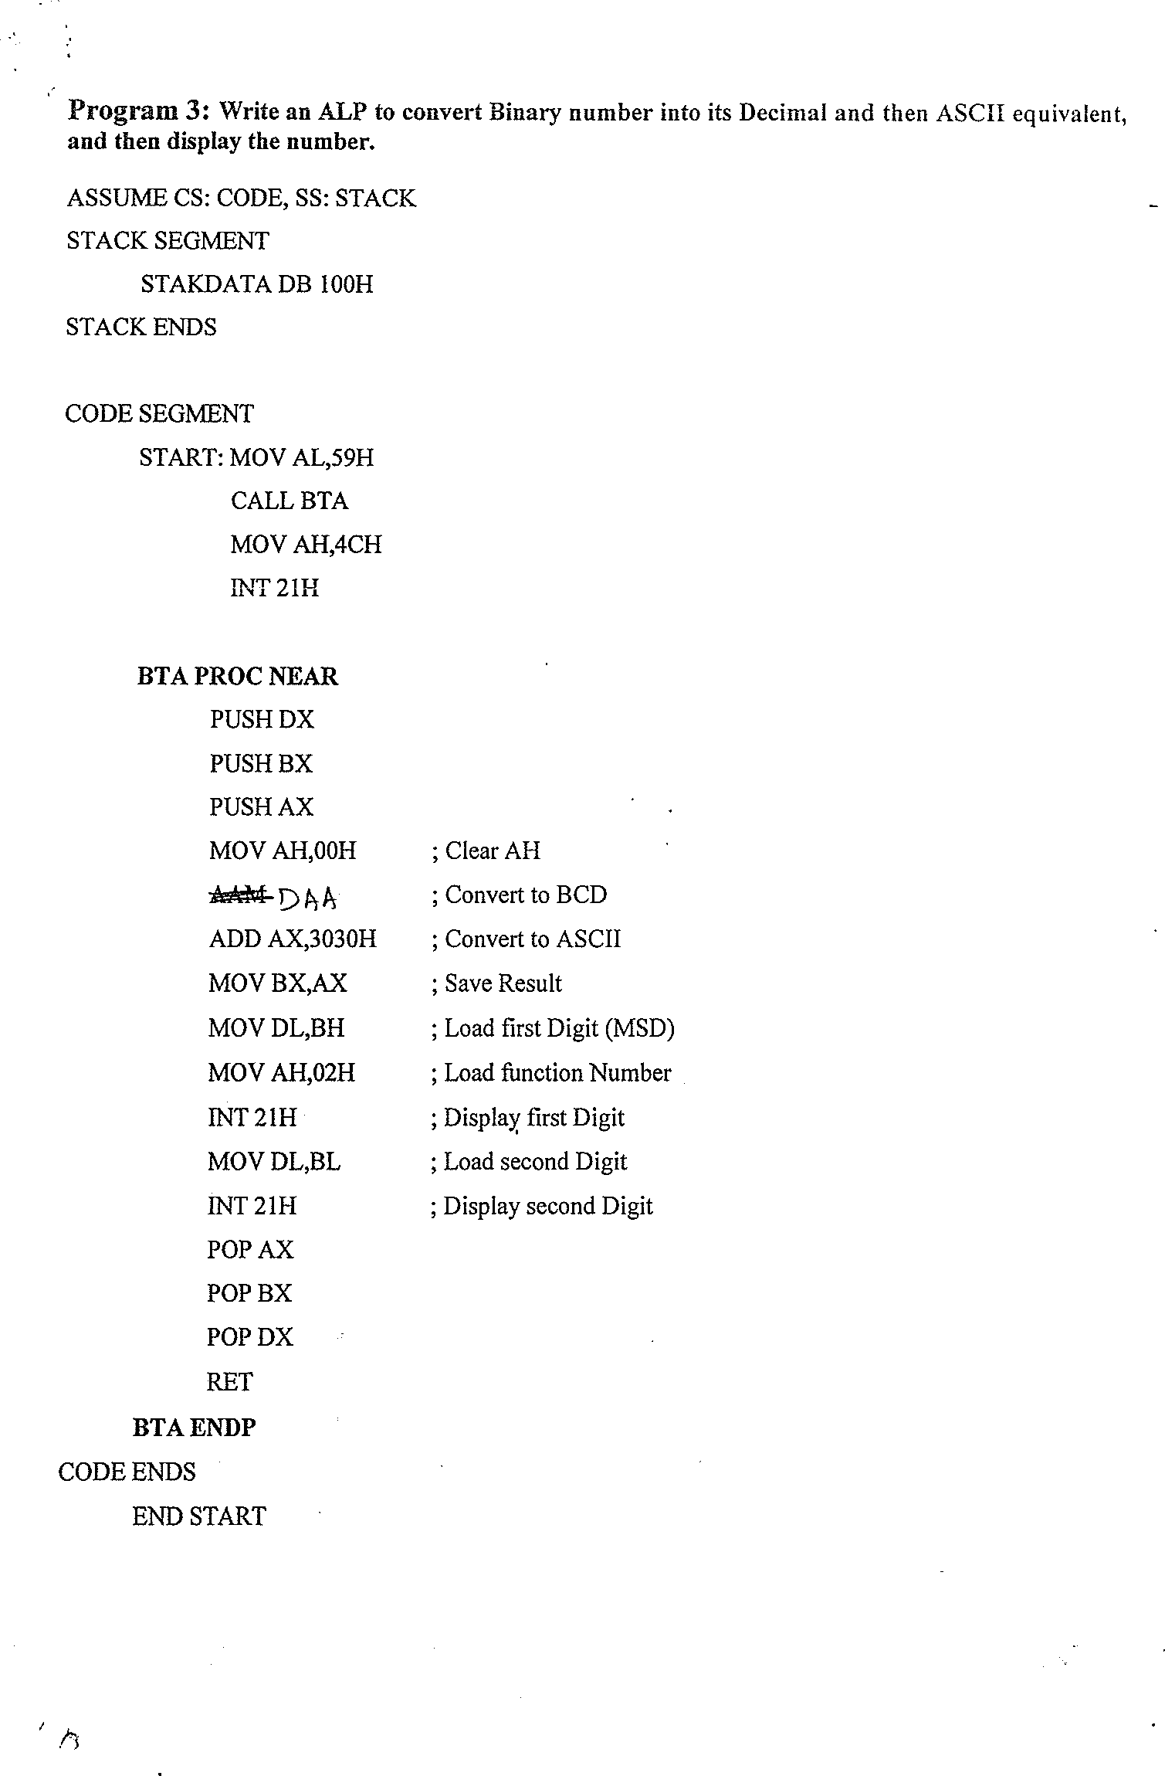

Slide 21
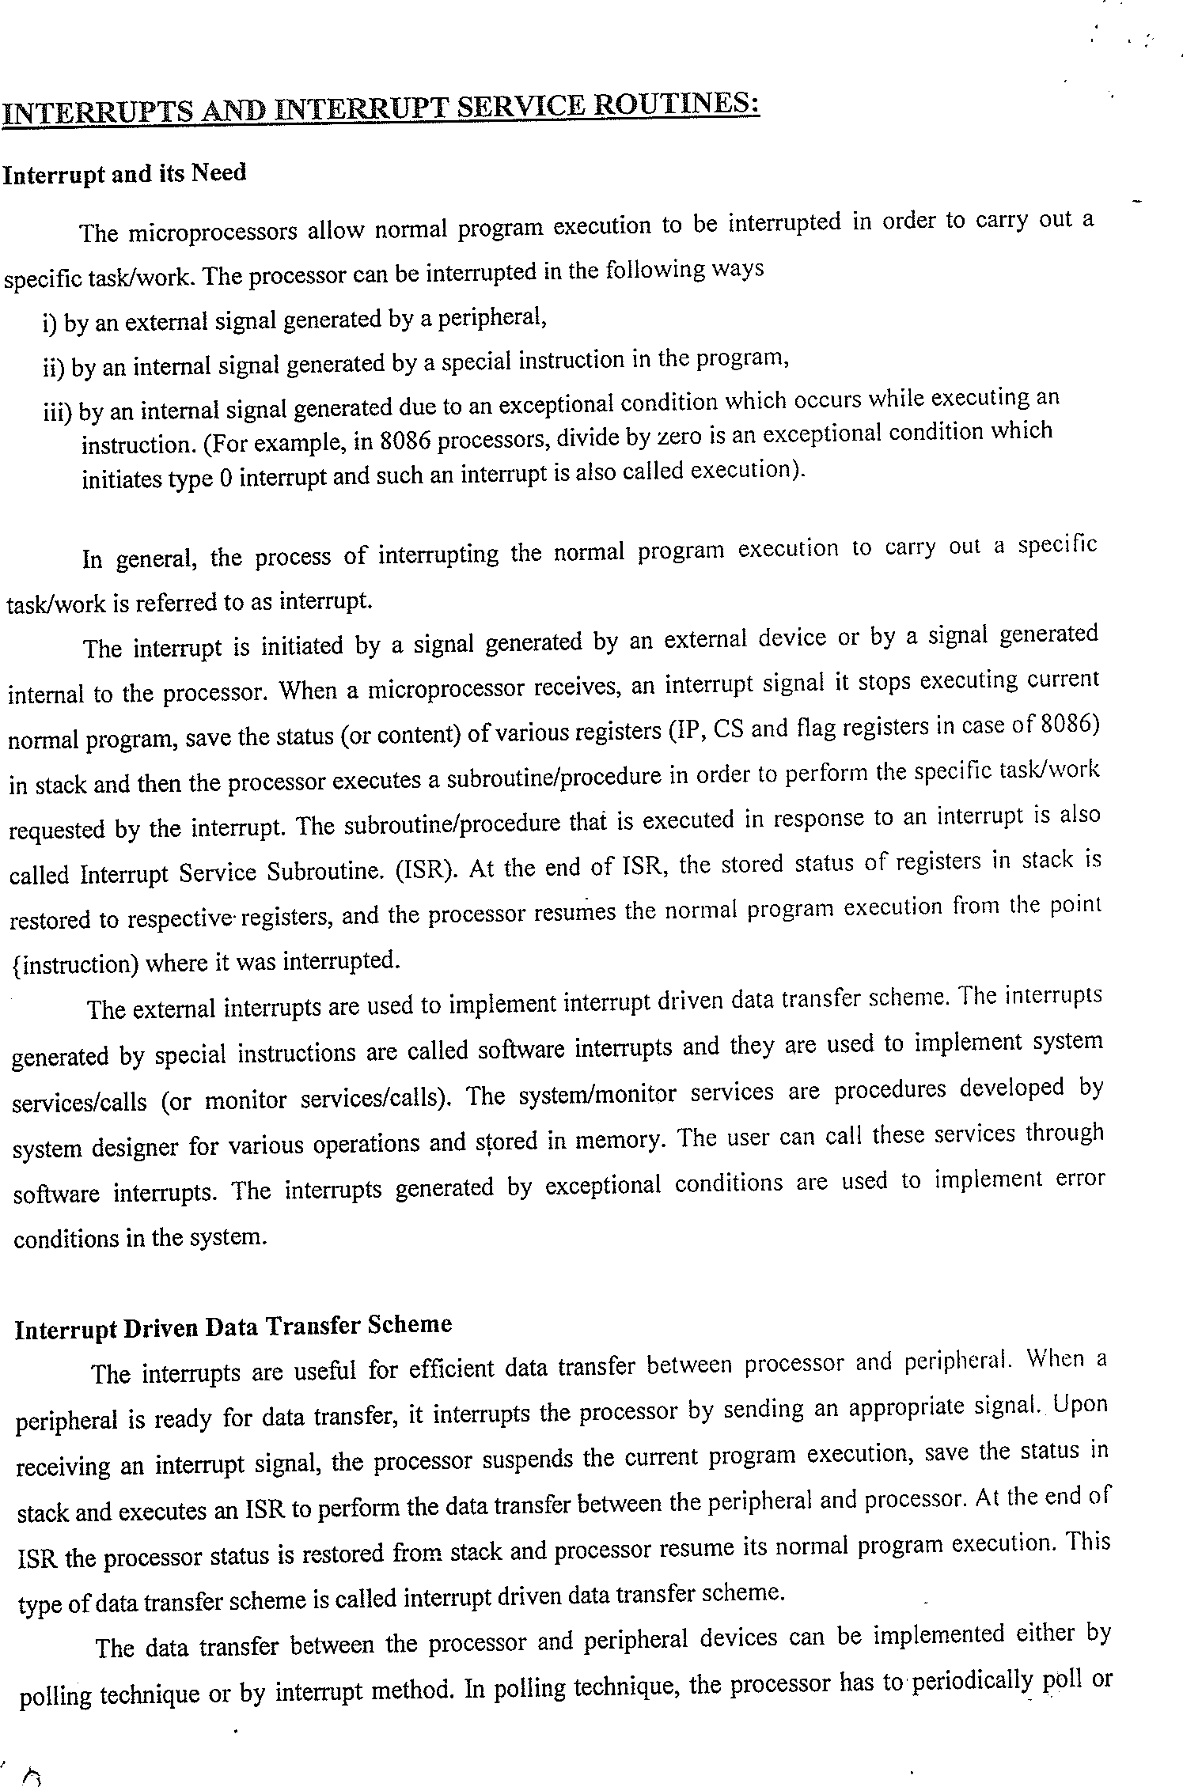

Slide 22
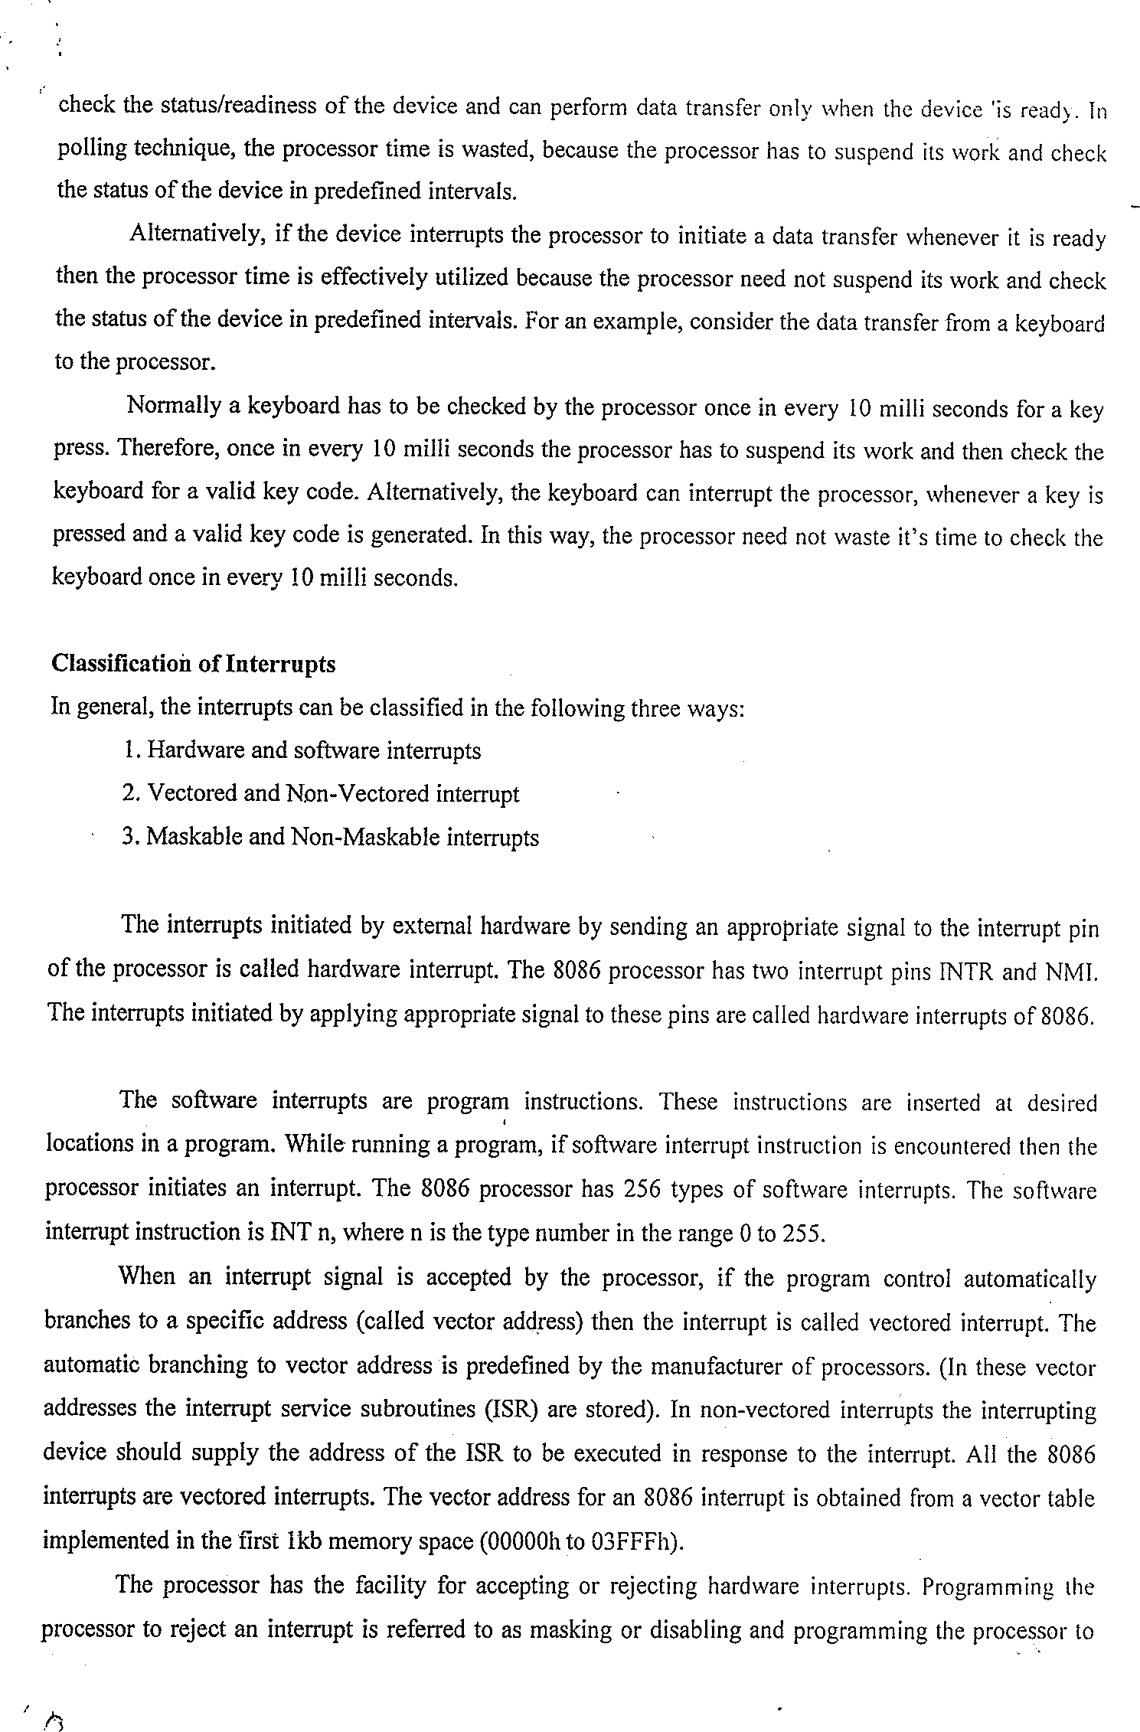

Slide 23
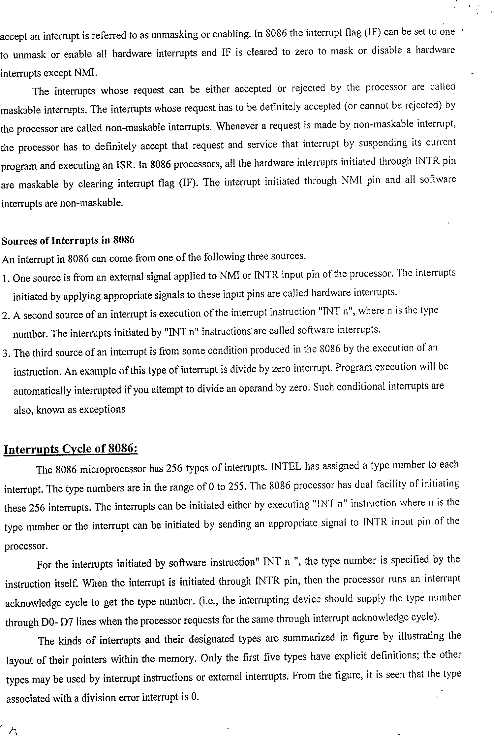

Slide 24
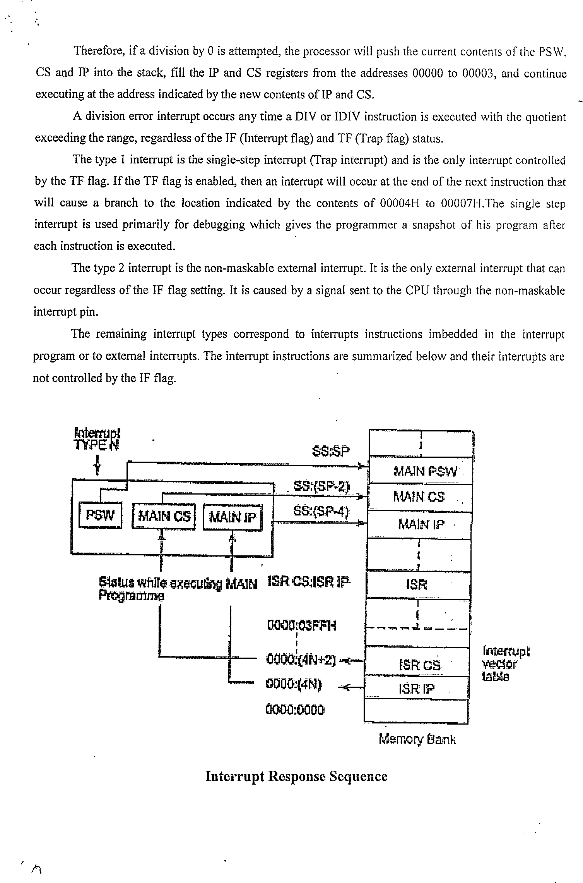

Slide 25
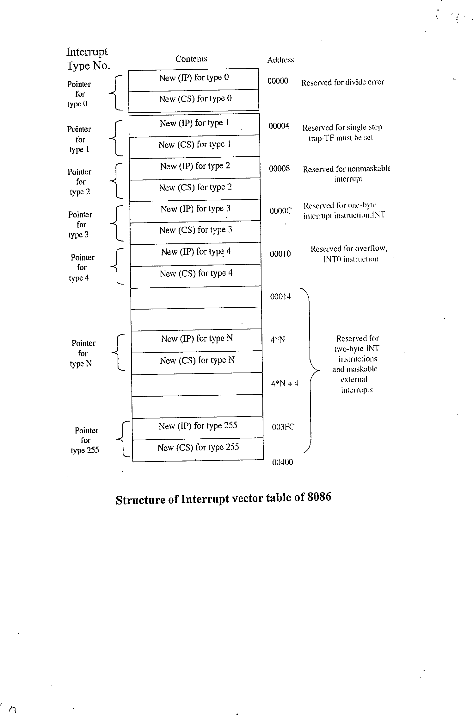
m

Slide 26
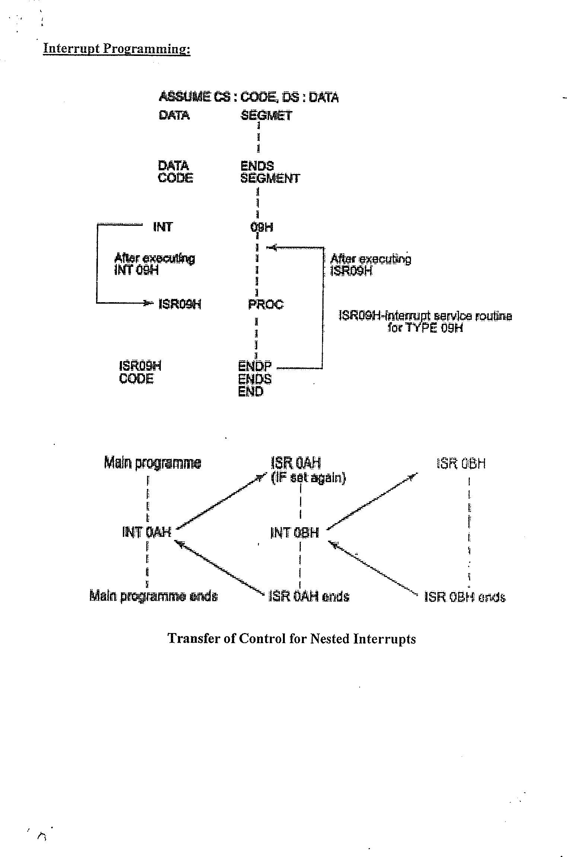

Slide 27
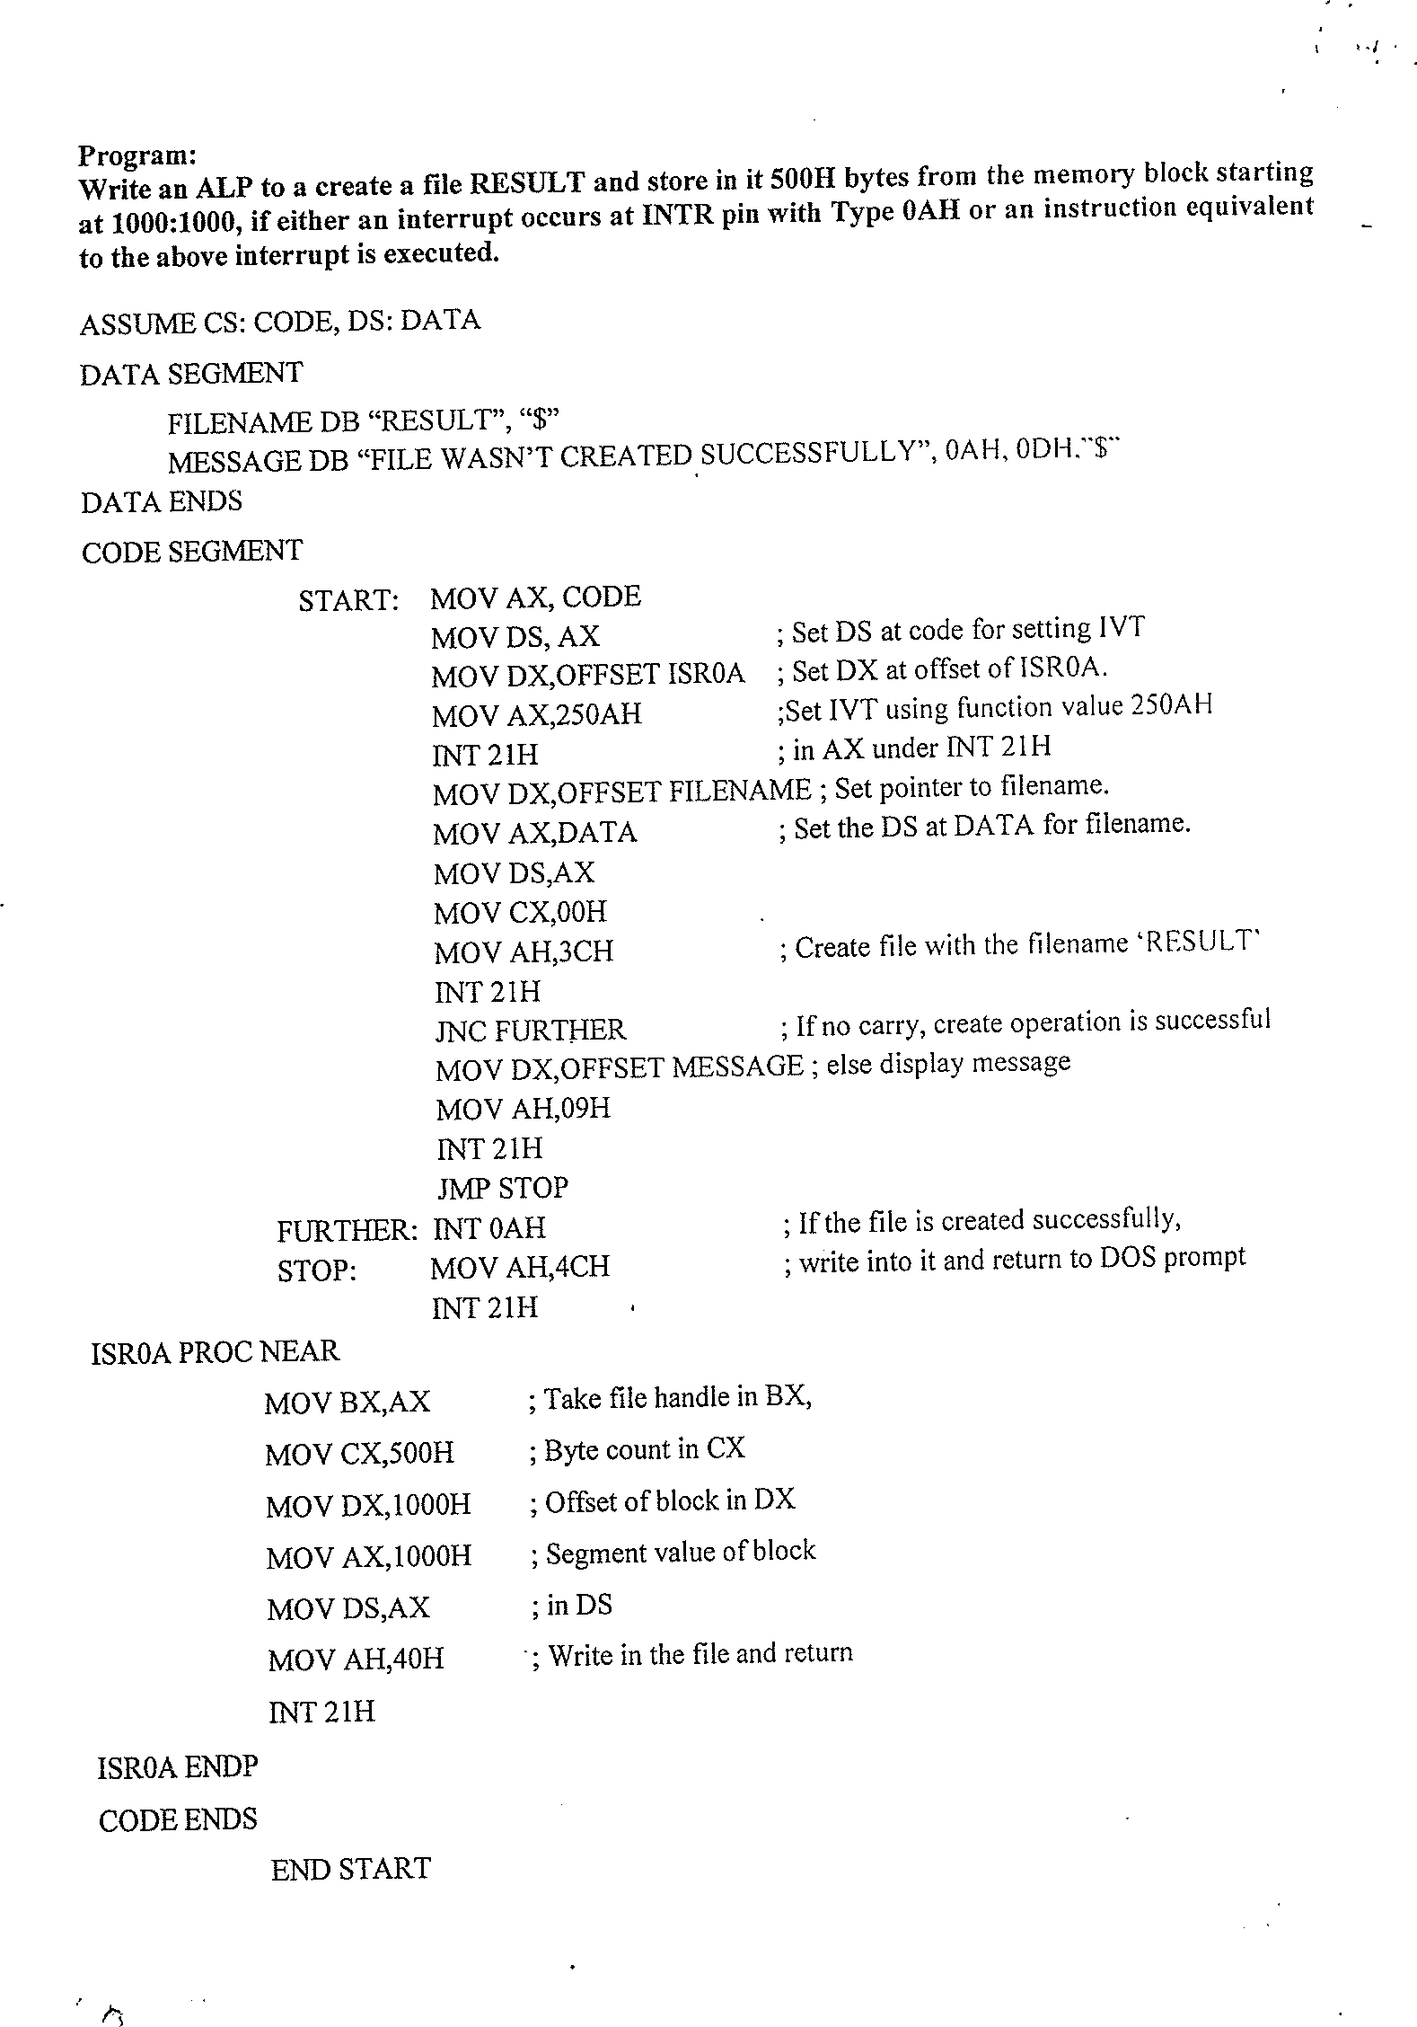

Slide 28
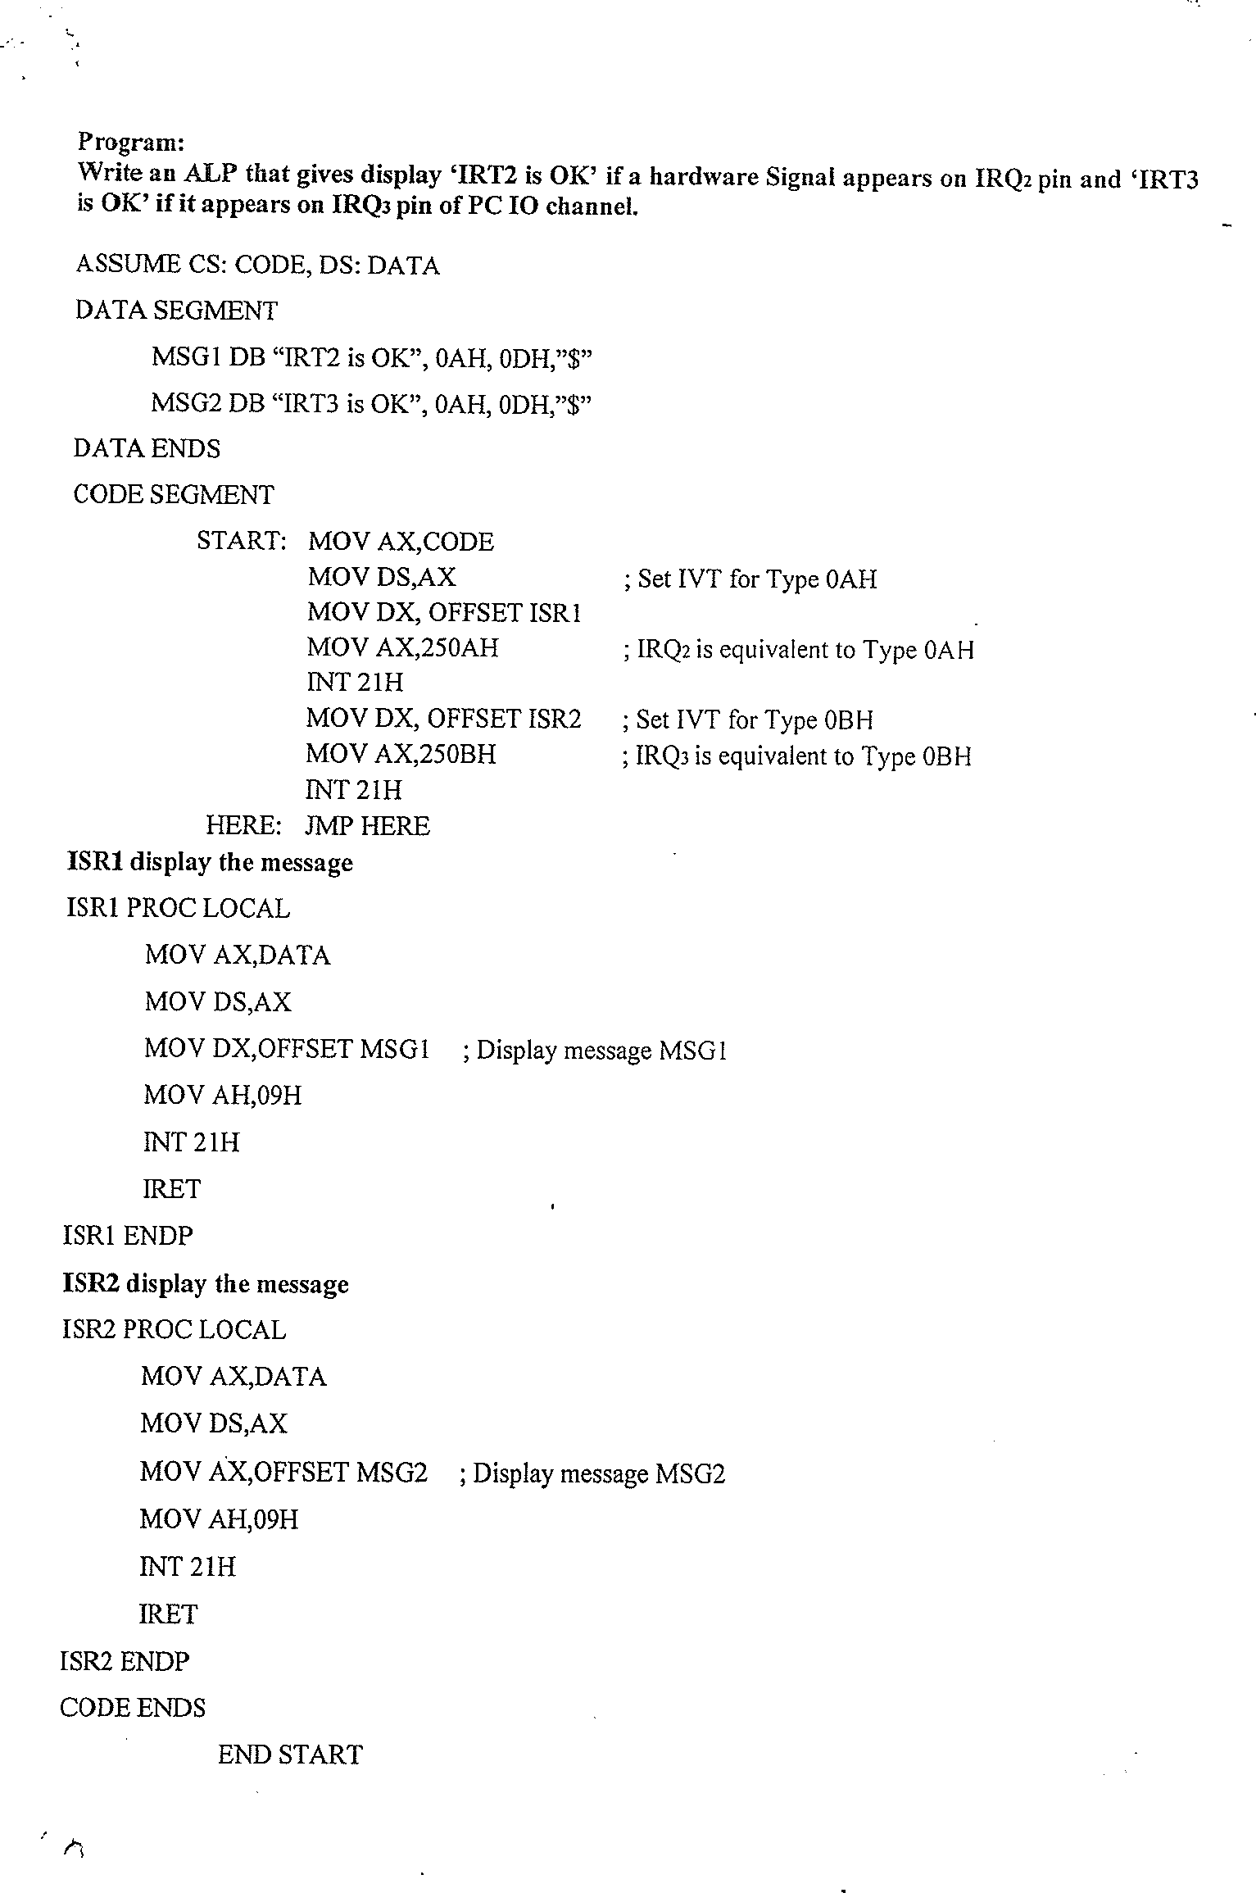

Slide 29
Assembly Language Program Development Tools:
Editor
  An editor is a program which allows you to create a file containing the assembly language statements for your program.
Example: PC-Write, Wordstar.
  As you type in your program, the editor stores the ASCII codes for the letters and numbers in successive RAM locations.
  When you have typed in your entire program, you then save the file on the hard disk.
This file is called source file and the extension is .asm.
Assembler
An assembler program is used to translate the assembly language mnemonics for instructions to corresponding binary codes. When you run the assembler, it reads the source file of your program from the disk where you have saved it after editing.
On the first pass through the source program, the assembler determines the displacement of named data items, the offset of labels, etc. and puts this information in a symbol table.
On the second pass through the source program, the assembler produces the binary code for each instruction and inserts the offsets, etc. that it calculated during the first pass.
The assembler generates 2 files on the floppy disk or hard disk. The first file is called object file (.obj).
The second file generated by assembler is called the assembler list file and is given extension (.lst).
Linker
  A linker is a program used to join several object files into one large object file.
  The linker produces a link file which contains the binary codes for all the combined modules.
  The linker also produces a link map file which contains the address information about the linked files (.exe).
Locator
A locator is a program used to assign the specific address of where the segments of object code are to be loaded into memory.
A locator program called EXE2BIN comes with the IBM PC Disk Operating System (DOS). EXE2BIN converts a .exe file to a .bin file which has physical addresses.
55

Slide 30
Debugger
  A debugger is a program which allows you to load your object code program into system memory, execute the program and troubleshoot or debug it.
  The debugger allows you to look at the contents of registers and memory locations after your program runs.
  It allows you to change the contents of registers and memory locations and re-run the program.
  Some debuggers allow you to stop execution after each instruction so that you can check or alter after each register contents.
  A debugger also allows you to set a breakpoint at any point in your program. If you insert a breakpoint at any point in your program, the debugger will run the program up to the
instruction where you put the breakpoint and then stop the execution.
Emulator
  An emulator is a mixture of hardware and software.
  It is used to test and debug the hardware and software of an external system, such as the
prototype of a microprocessor based instrument. Part of the hardware of an emulator is a multi wire cable which connects the host system to the system being developed.
56

